Slide 1
RECIPE PREPARATION AGENT
AGENTIC AI PROJECT
Presented By:
1. SHUBHAM SHARMA - UNIVERSITY OF LUCKNOW - CSE(AI)

Slide 2
OUTLINE
Problem Statement
Proposed System/Solution
System Development Approach
Algorithm & Deployment
Result
Conclusion
Future Scope
References

Slide 3
Problem Statement
Example: A Recipe Preparation Agent helps users cook meals using only the ingredients they have on hand. By inputting available groceries, users receive tailored recipe suggestions using a RAG-based AI system. The agent retrieves relevant recipes and generates step-by-step instructions adapted to ingredient limitations. It offers substitutions, cooking tips, and dietary adjustments based on user preferences or restrictions. Designed to reduce food waste and save time, it turns pantry items into practical meal solutions. This AI assistant makes everyday cooking smarter, simpler, and more sustainable.

Slide 4
Proposed Solution
The proposed system aims to address the challenge of preparing personalized recipes based on user preferences and available ingredients. This involves leveraging data analytics and machine learning techniques to recommend dishes accurately. The solution will consist of the following components:
Data Collection: Gather historical data on recipes, including ingredients, cooking time, cuisine type, and dietary factors. Utilize real-time data sources, such as available pantry items, user allergies, and nutritional goals, to enhance recommendation accuracy.
Data Preprocessing: Clean and preprocess the collected data to handle missing entries, measurement errors, and inconsistencies. Feature engineering to extract relevant features from the data that might influence recipe suitability.
Machine Learning Algorithm: Implement a machine learning algorithm, such as a recommendation system (e.g., content-based or collaborative filtering), to suggest recipes based on user history. Consider incorporating other factors like seasonality, cuisine preference, and dietary restrictions to improve recipe relevance.
Deployment: Develop a user-friendly interface or application that provides real-time personalized recipe suggestions. Deploy the solution on a scalable and reliable platform, considering factors like cloud storage, response time, and device compatibility.
Evaluation: Assess the model's performance using appropriate metrics such as precision, recall, F1-score, or user satisfaction ratings. Fine-tune the model based on user feedback and continuous monitoring of suggestion accuracy.

Slide 5
System Approach
The "System Approach" section outlines the overall strategy and methodology for developing and implementing the RECIPE PREPARTION prediction system. Here's a suggested structure for this section:
System requirements
Library required to build the model

Slide 6
Algorithm & Deployment
In the Algorithm section, describe the machine learning algorithm chosen for recommending personalized recipes. Here's an example structure for this section:
Algorithm Selection: Provide a brief overview of the chosen algorithm (e.g., collaborative filtering or content-based model) and justify its selection based on the problem scope and data attributes.
Data Input: Specify the input features used by the algorithm, such as available ingredients, past recipe selections, dietary restrictions, and other relevant user preferences.
Training Process: Explain how the algorithm is trained using historical recipe interaction data. Highlight any specific techniques or considerations, such as user clustering or model fine-tuning.
Prediction Process: Detail how the trained algorithm suggests recipes based on input data. Discuss how it integrates real-time availability of ingredients or seasonal constraints during prediction.

Slide 7
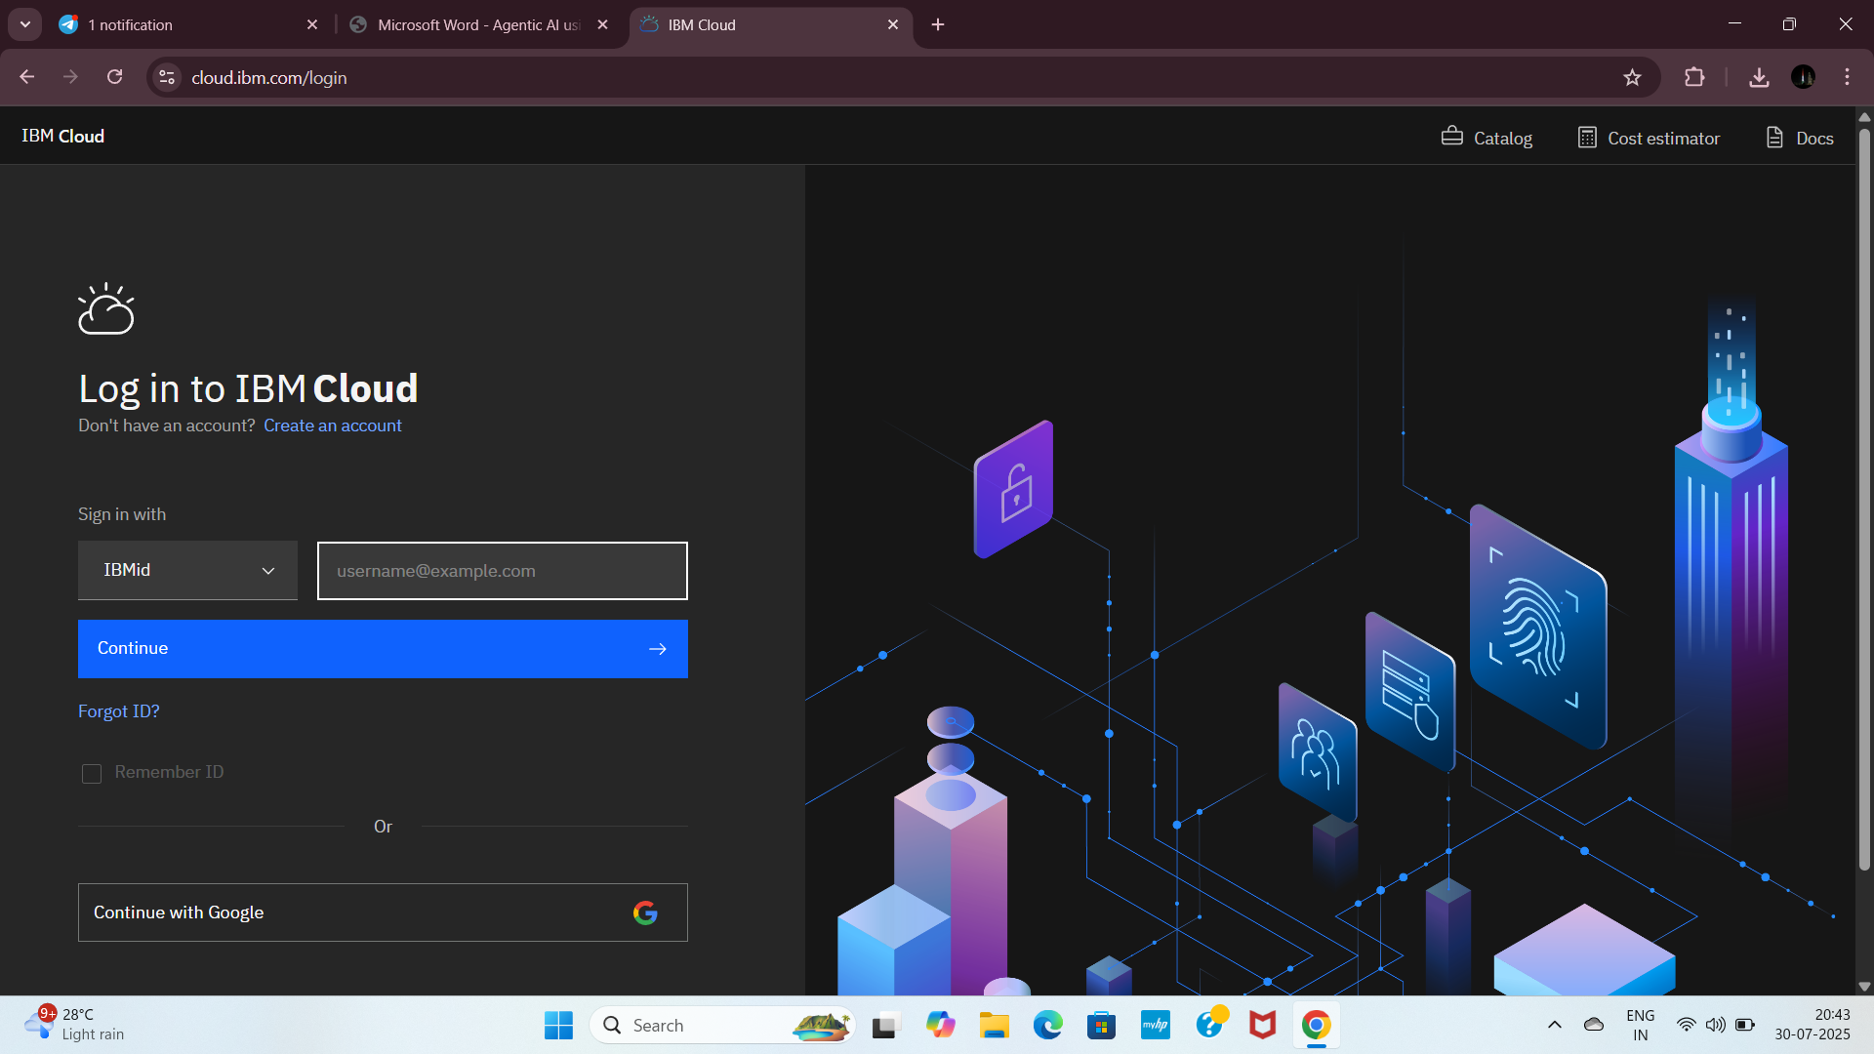
RECIPE AGENT USING AI
Step1: Open IBM Cloud login page with this link cloud.ibm.com, enter your Gmail and click on Continue

Slide 8
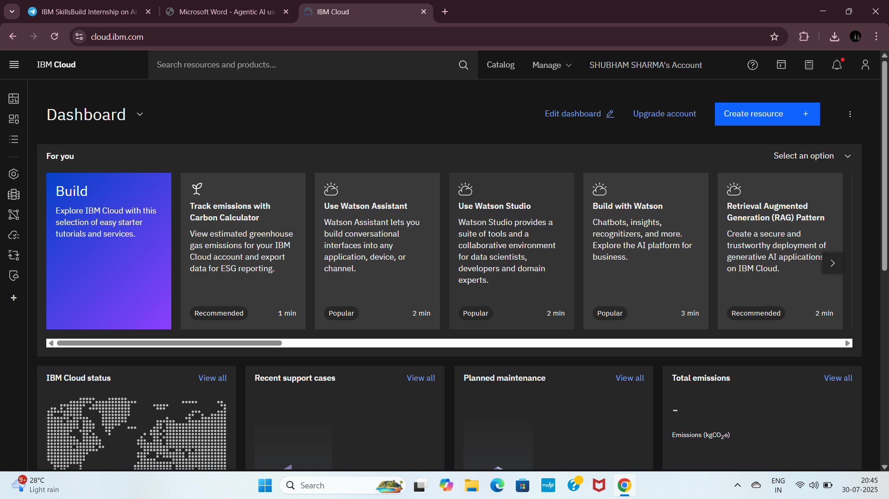
STEP2- USE CONTINUE WITH GOOGLE AND THIS PAGE APPEARS

Slide 9
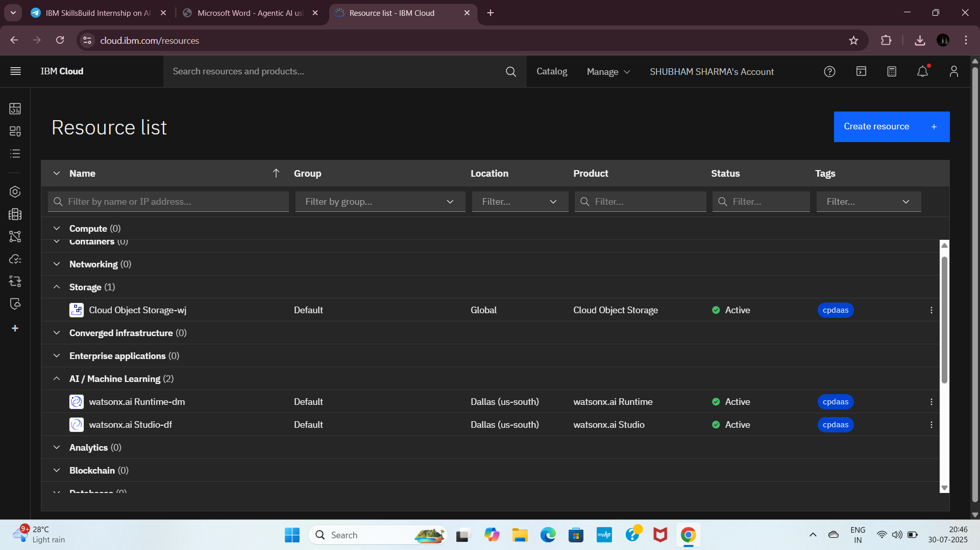
STEP3-CLEAR THE PREVIOUS REESOURCES

Slide 10
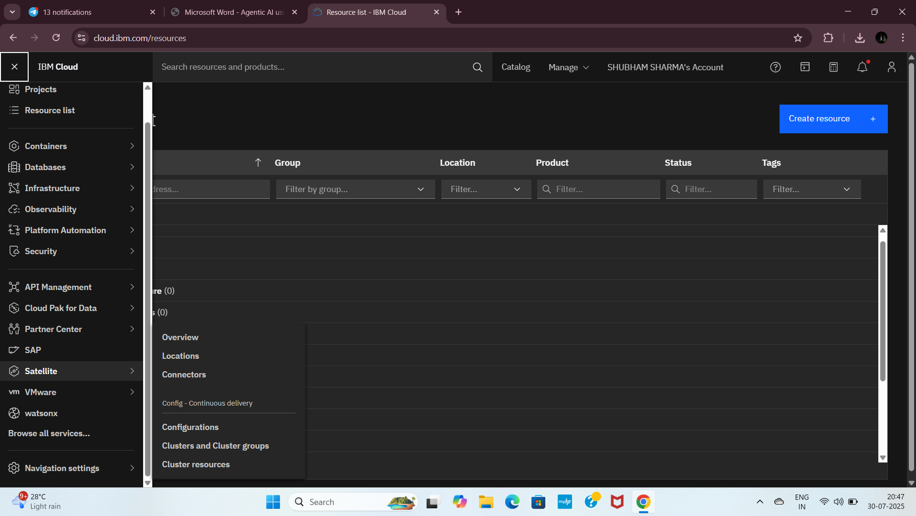
STEP4-CLICK ON THE NAVIGATION KEY THE THREE LINES AT THE TOP LEFT CORNER AND THEN CLICK ON WATSONX

Slide 11
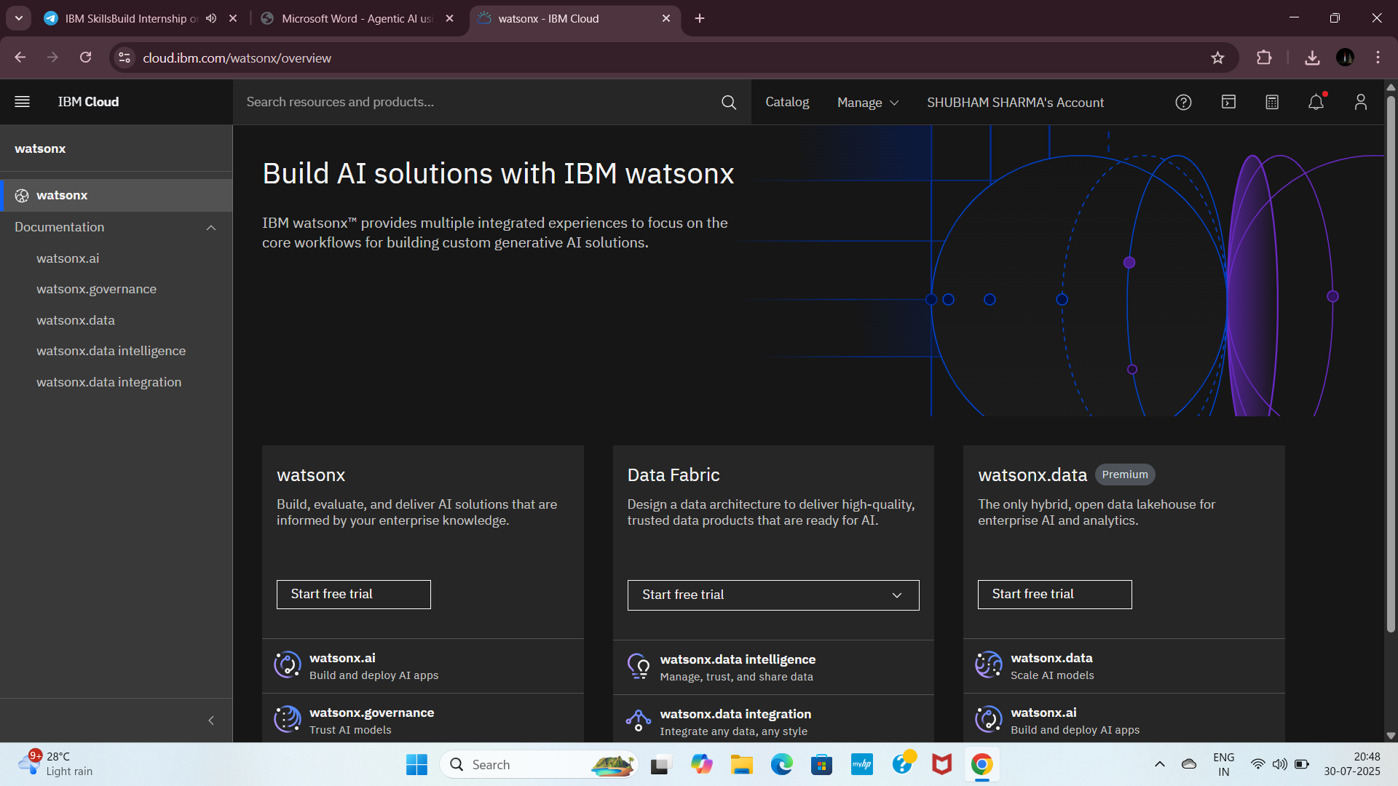
Step5: This is the interface, now click on Watsonx.ai. (from Documentation tab)

Slide 12
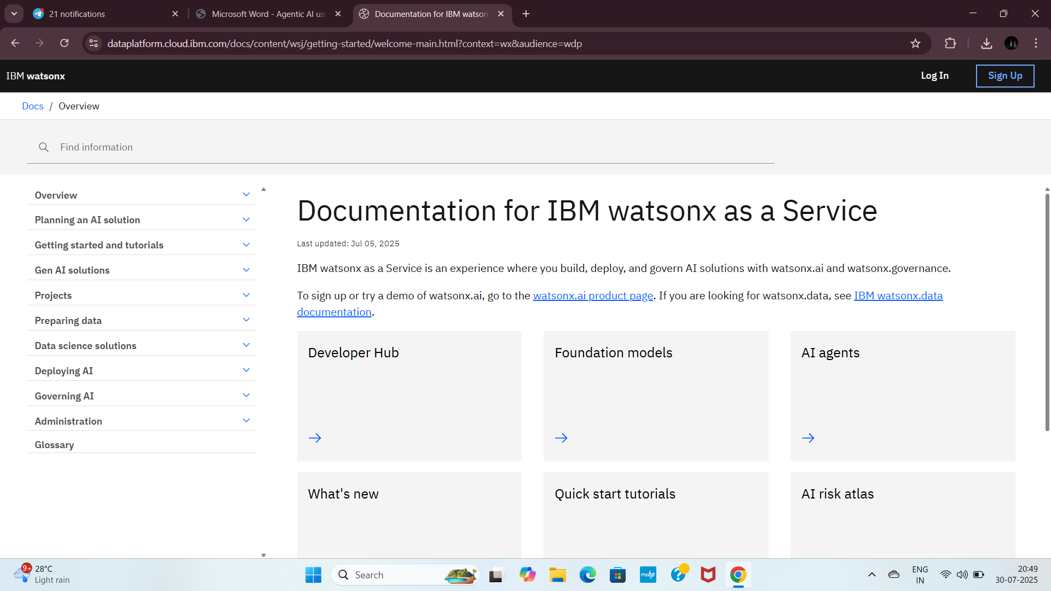
Step6: Choose AI agents.

Slide 13
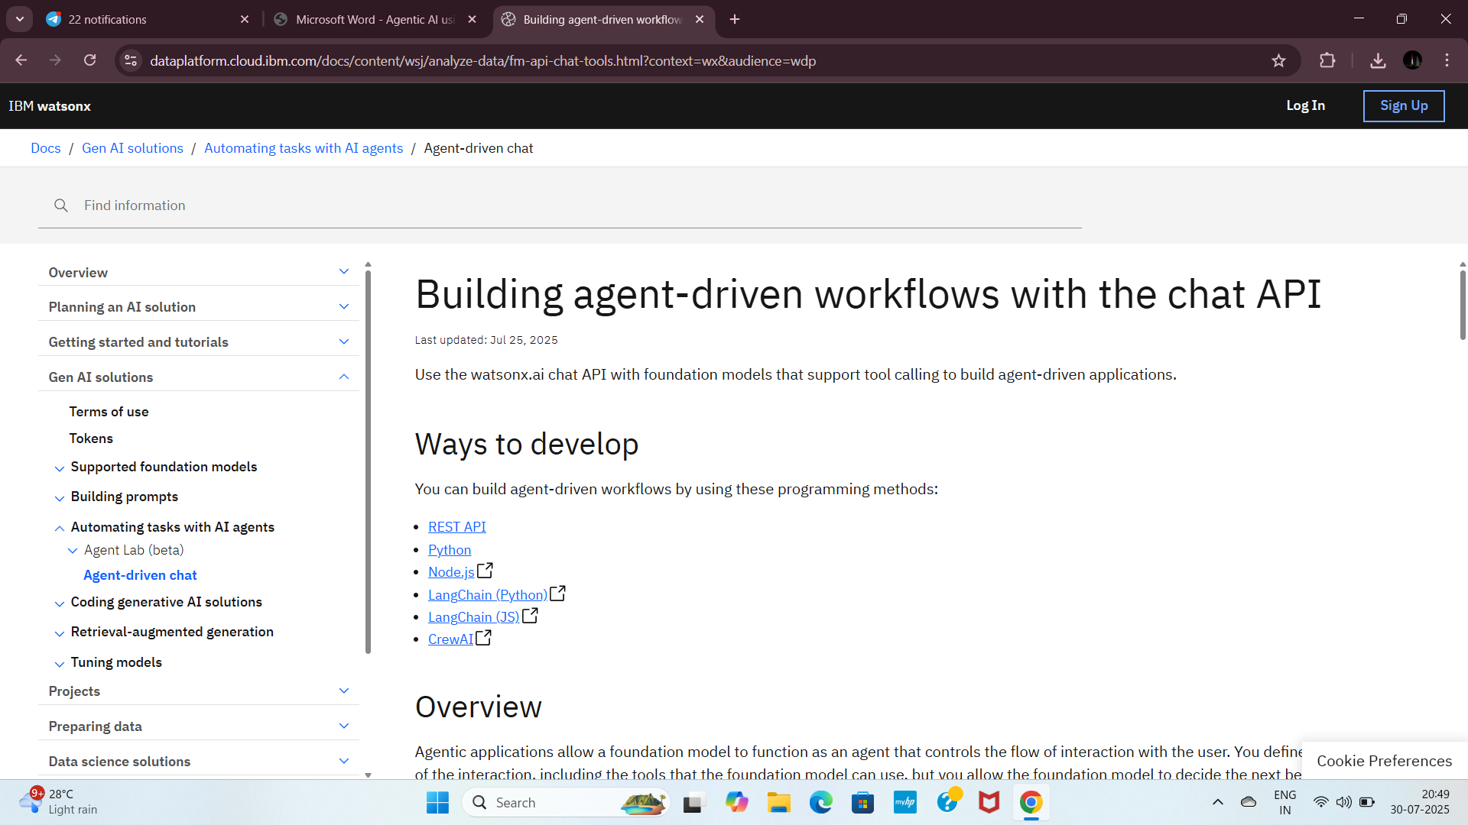
Step7: Scroll down a little, then click on Agentic Lab and click on Watsonx.ai homepage

Slide 14
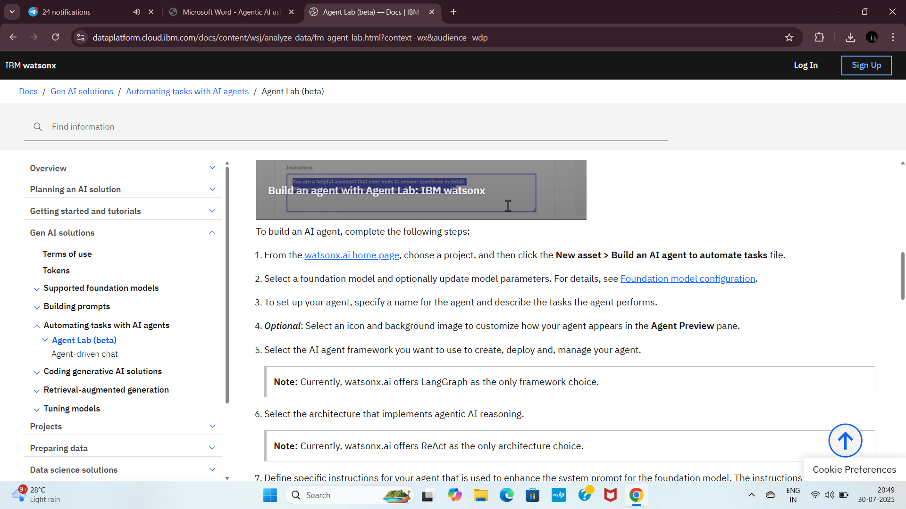

Slide 15
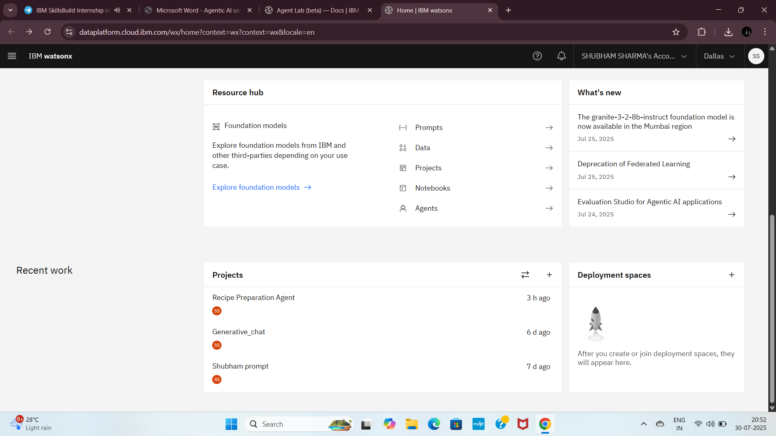
Step8: This is next interface, now scroll down this page, create project (+) icon

Slide 16
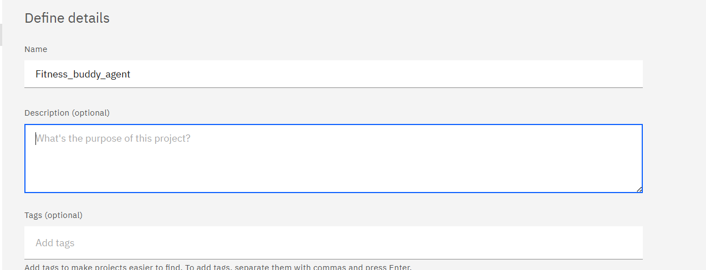
Step09: Enter your project name and scroll down.

Slide 17
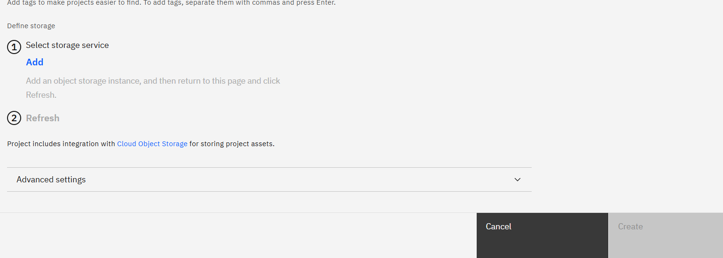
STEP10-CLICK ON ADD BUTTON

Slide 18
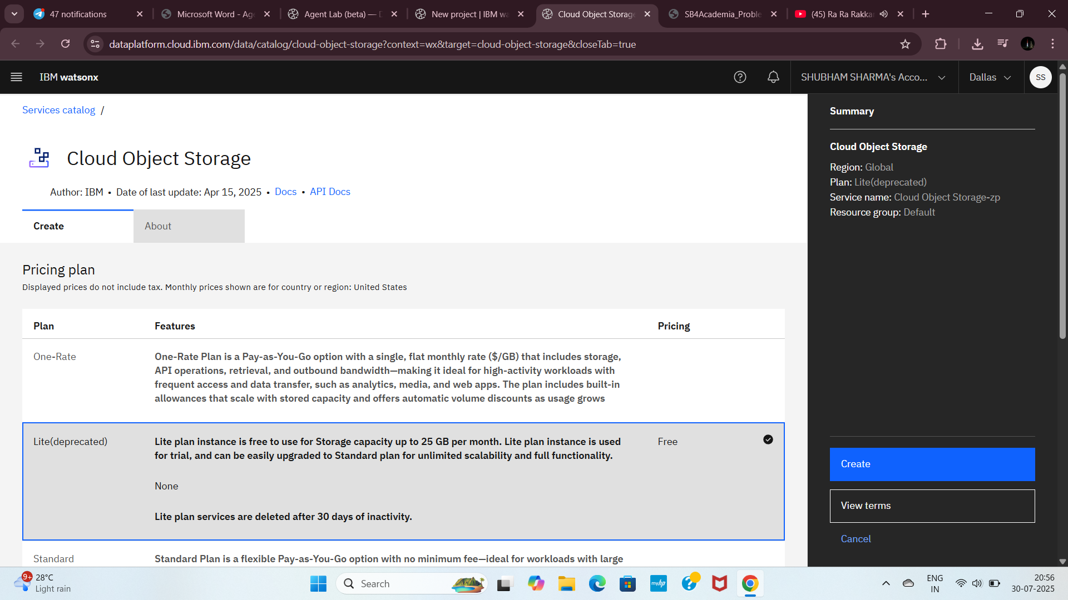
Step11: Choose second plan, which is free plan, click on Create.

Slide 19
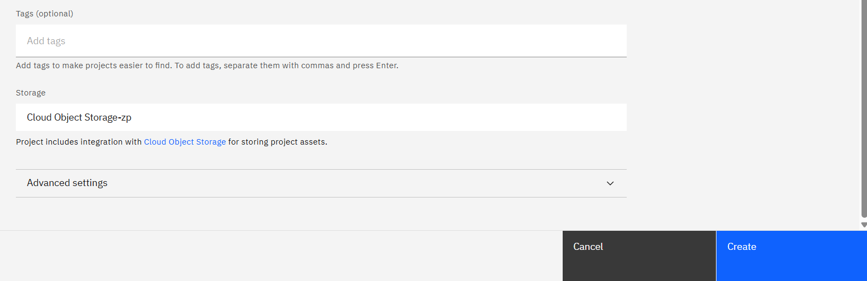
Step12: click on Refresh, click on Create.

Slide 20
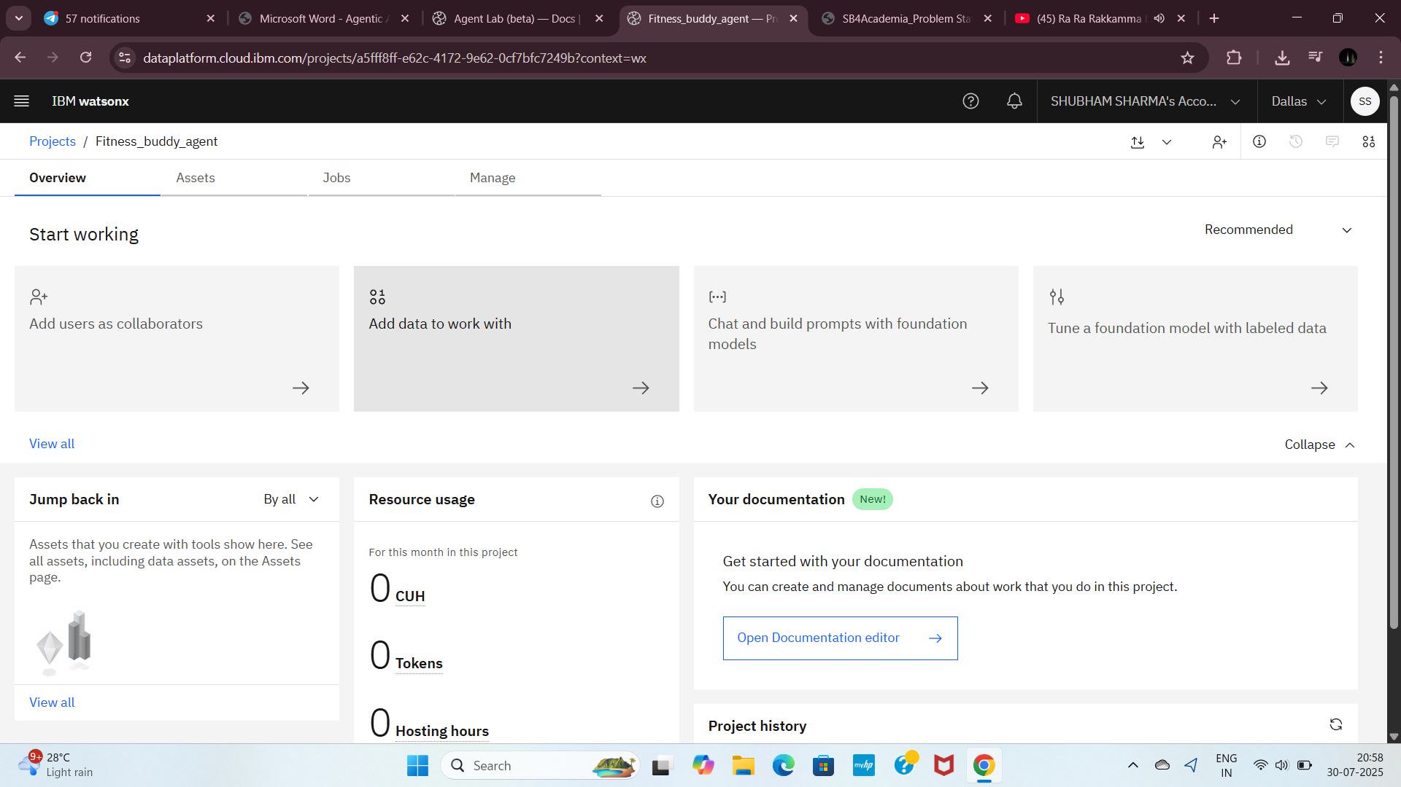
Step13: This page opened. (Don’t do anything here)

Slide 21
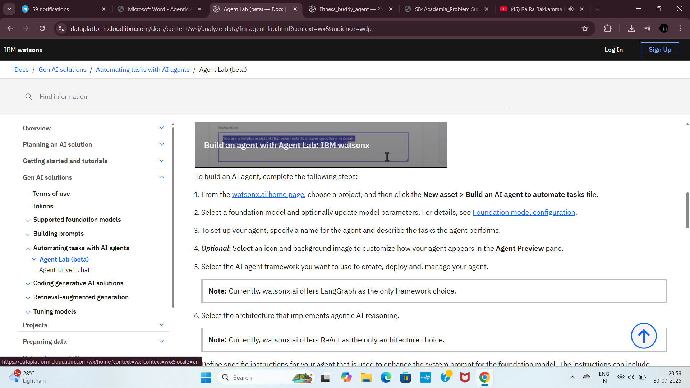
Step14: Go to the previous tab in browser.(remember this step).

Slide 22
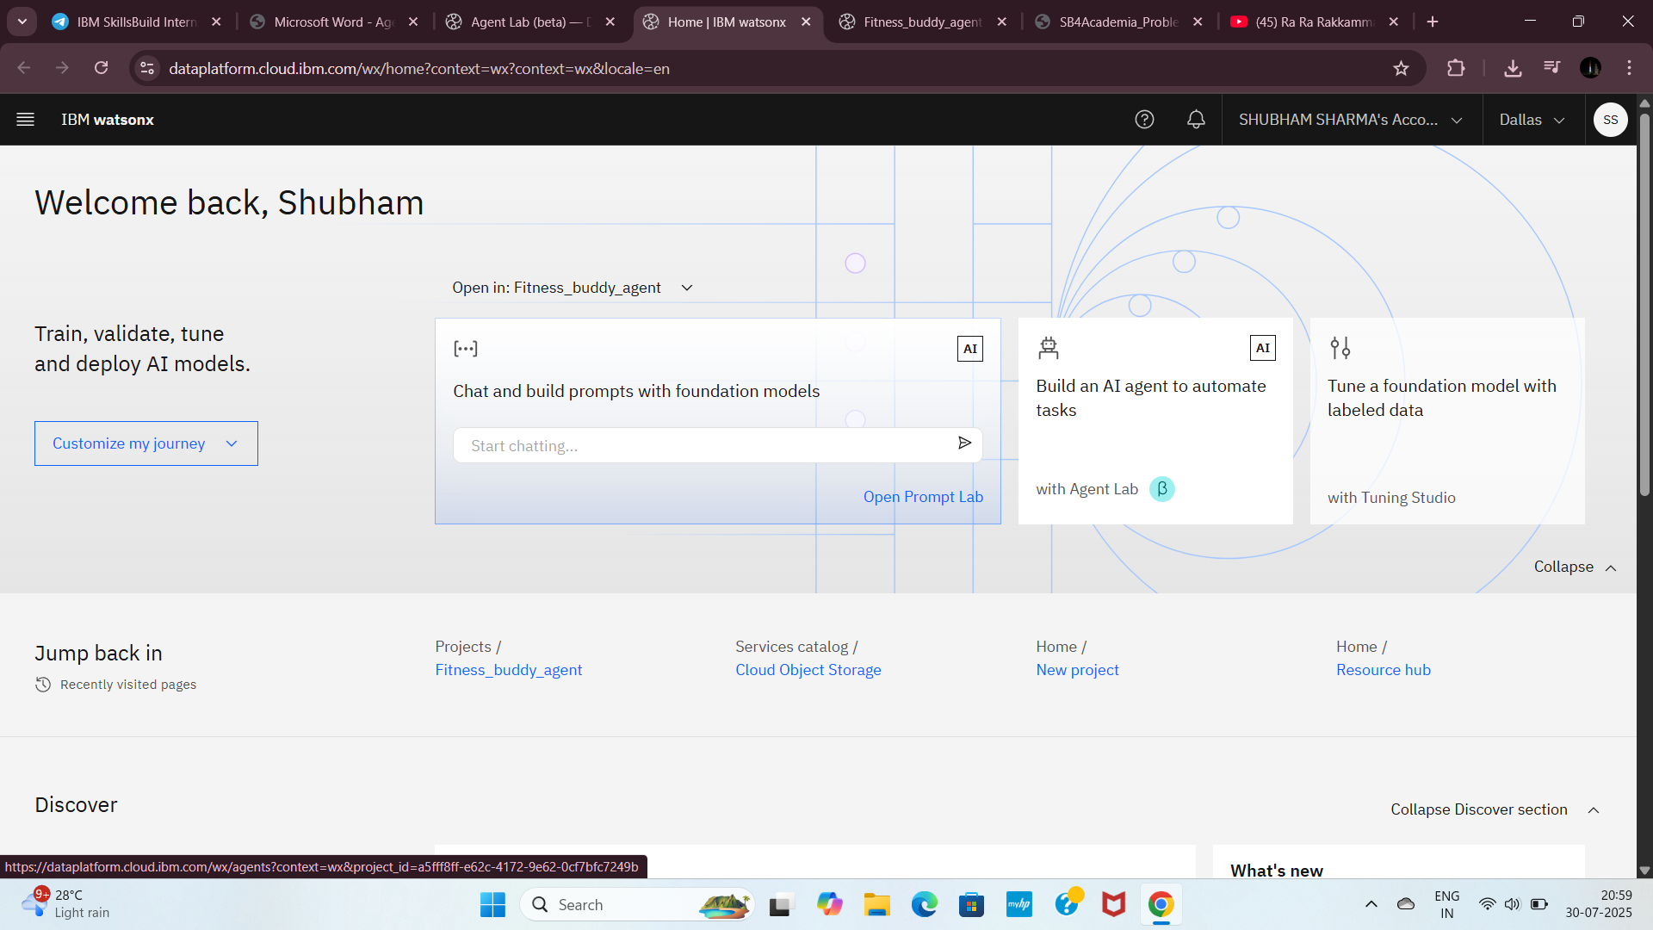
Step15: Click on Watsonx.ai home page and this tab appears

Slide 23
Step16: Now you can click on Build an AI agent to automate tasks.(If you not in this page during this experiment kindly check previous step. carefully)

Slide 24
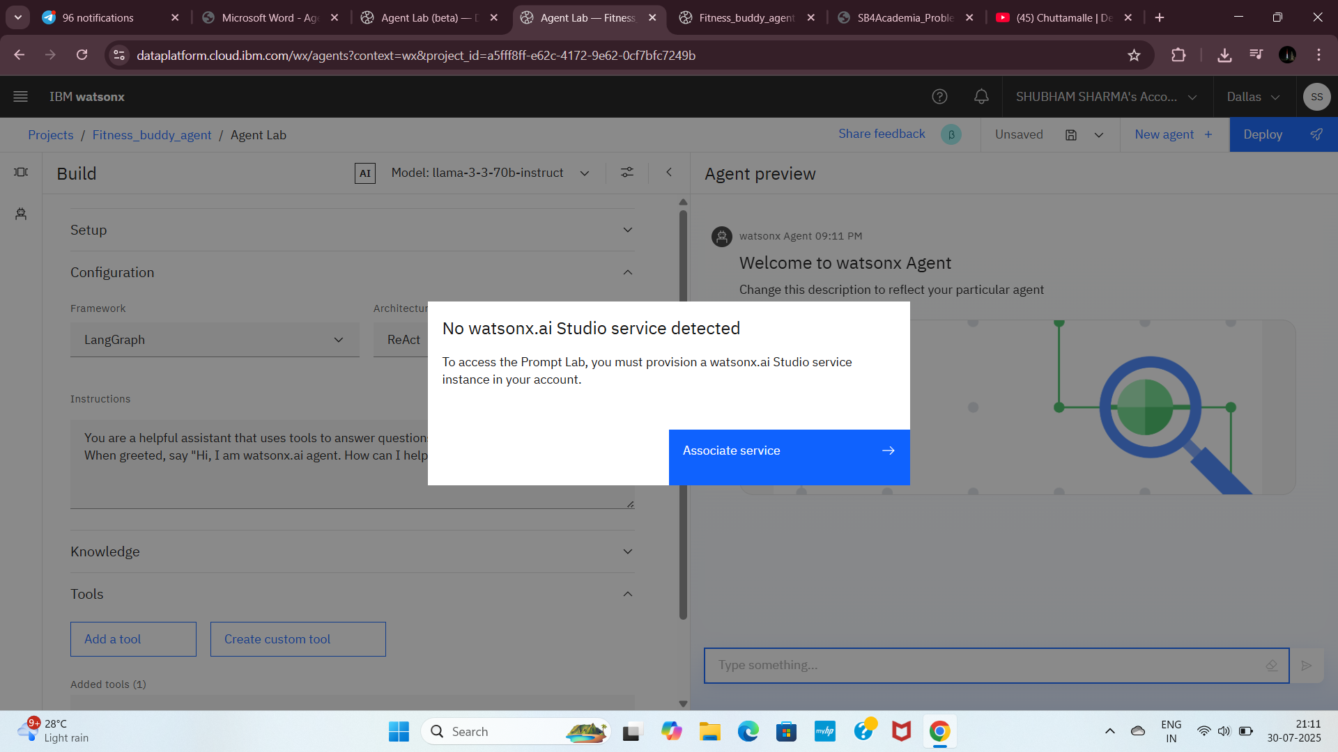
Step17: Click on Associate service

Slide 25
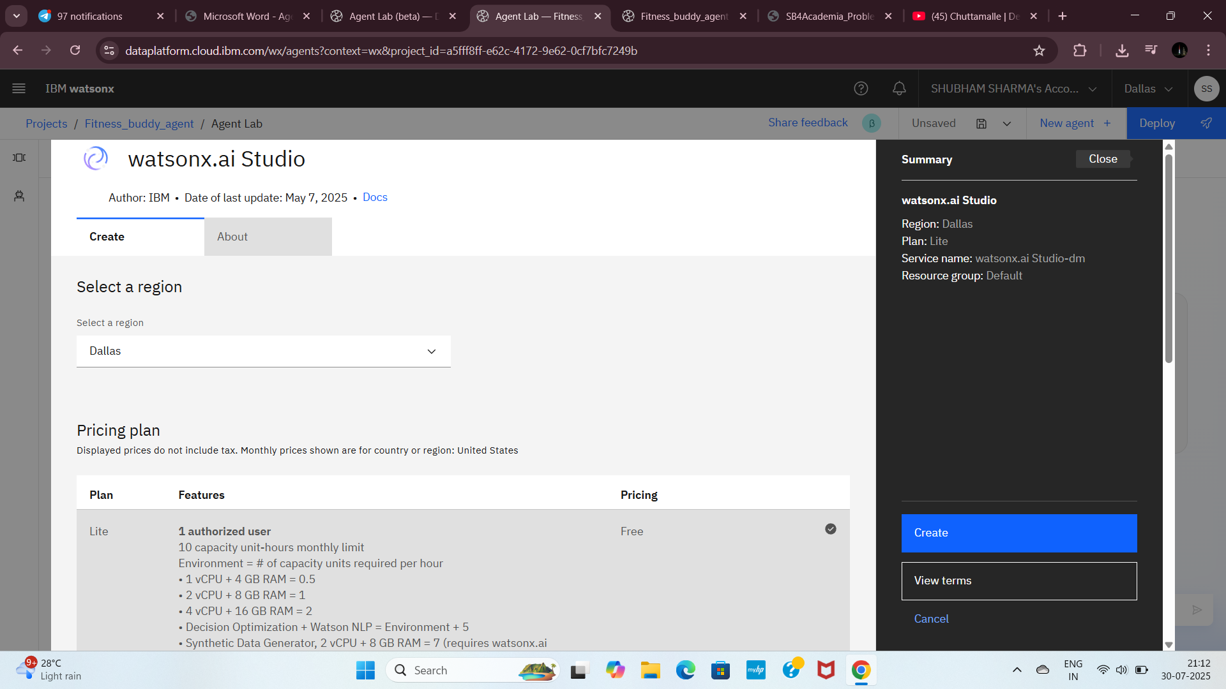
Step18:Choose a free plan and then Click on Create

Slide 26
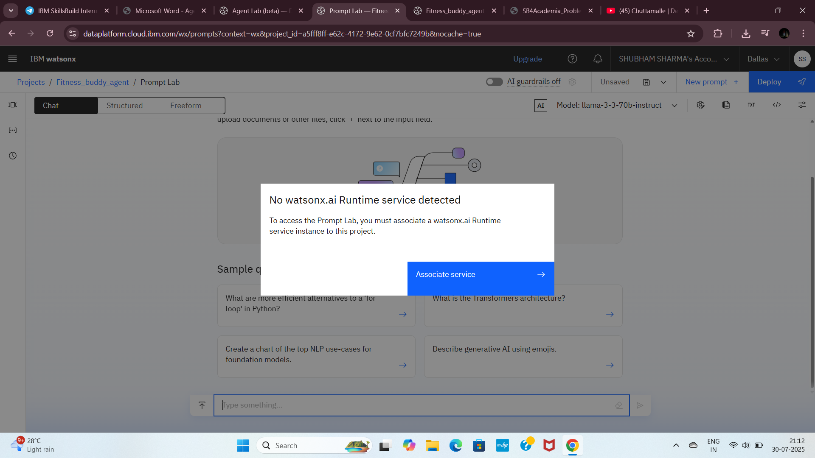
Step19: Click on Associate service.(This service is Watsonx.ai Runtime service)

Slide 27
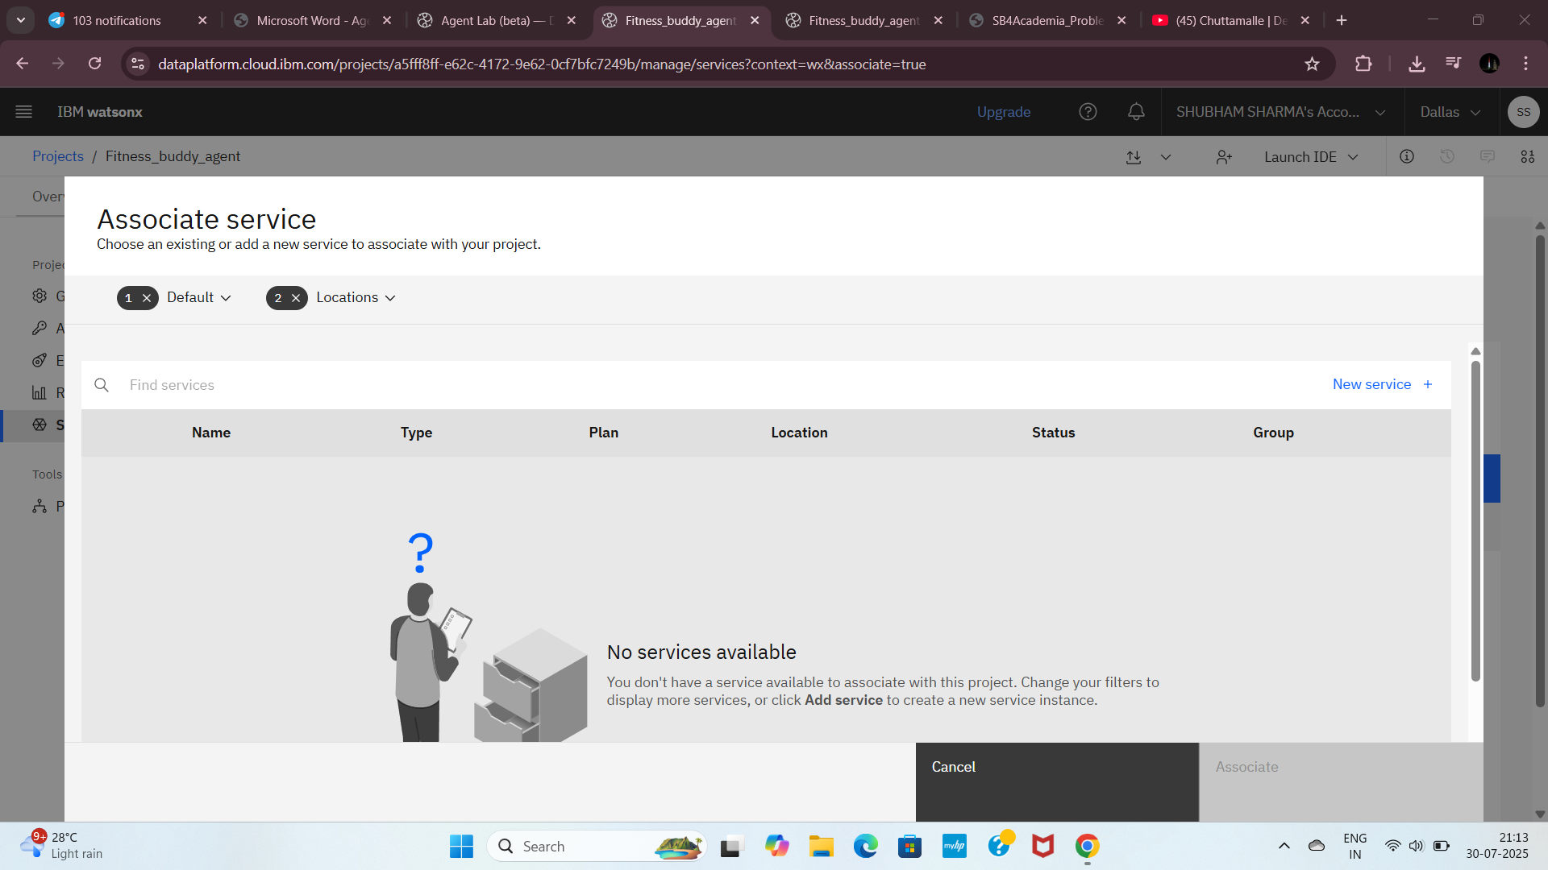
Step20: Click on New service.

Slide 28
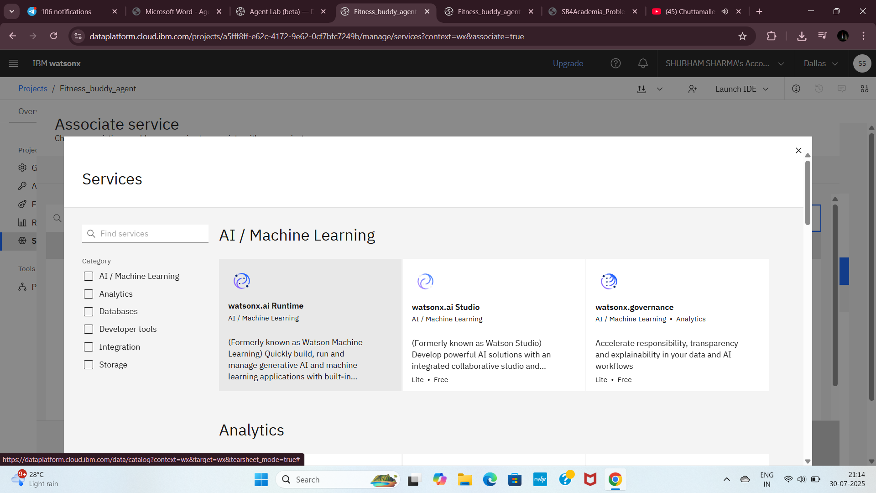
Step21: Click on Watson.ai Runtime & Click on Create.

Slide 29
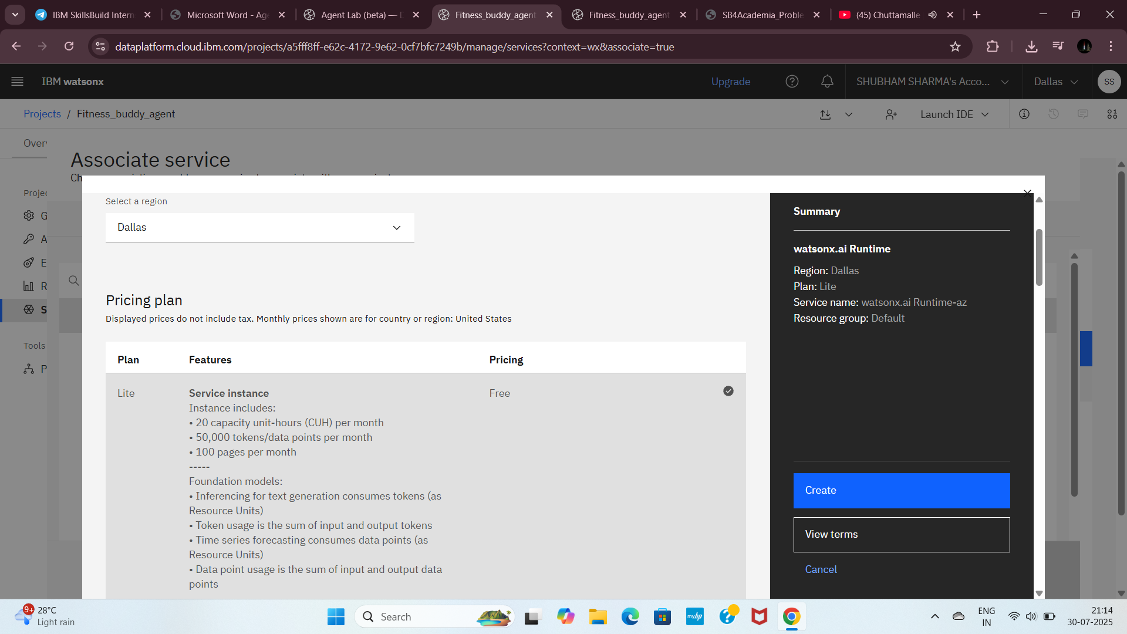
STEP22-CLICK ON CREATE BUTTON

Slide 30
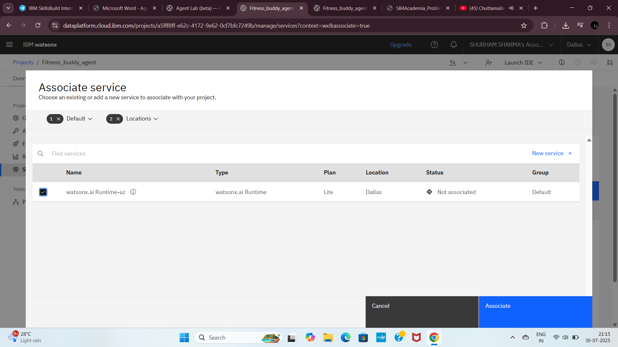
Step23: Click on Watson.ai Runtime check box and click on Associate.

Slide 31
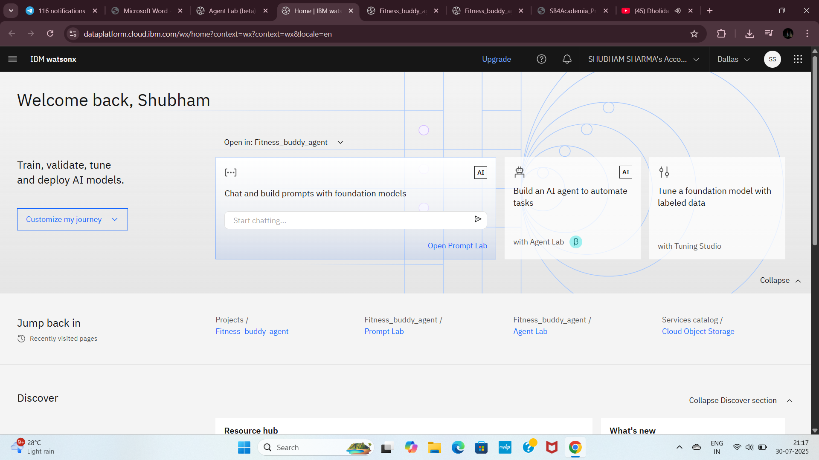
Step24: Repeat step17 & Step 18 i.e. go to the previous tab and then click on watsonx homepage. This the page. Click on Build AI agent to automate tasks.

Slide 32
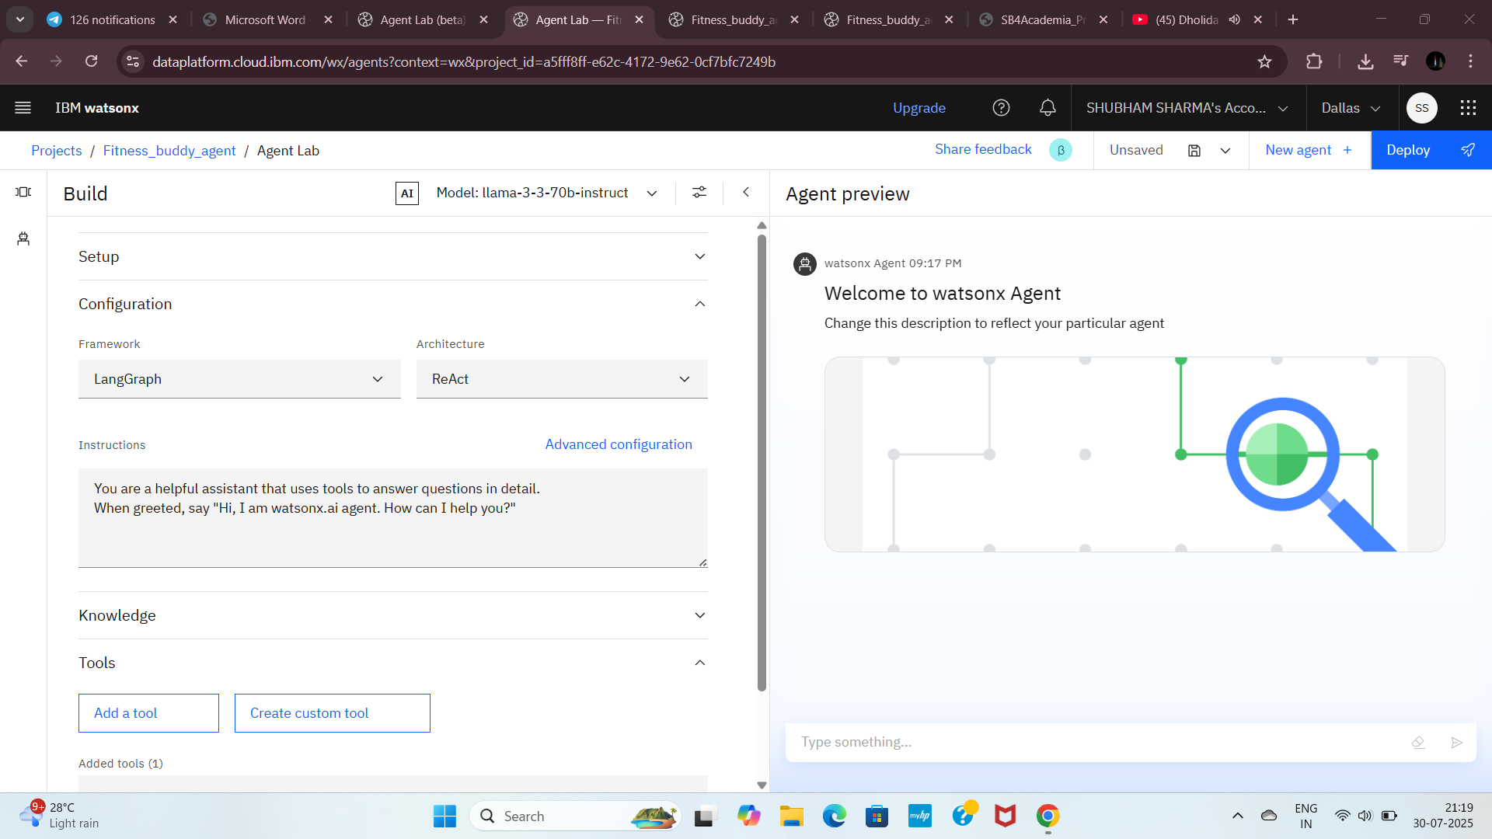
Step25:This is Watsonx Agent , now change the model here

Slide 33
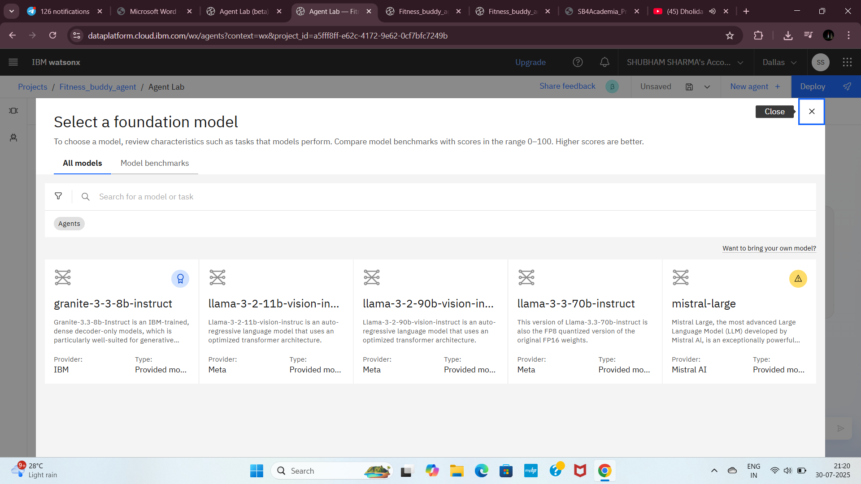
Step26: Click on “ View all foundation models” to change the model. Then select the large model

Slide 34
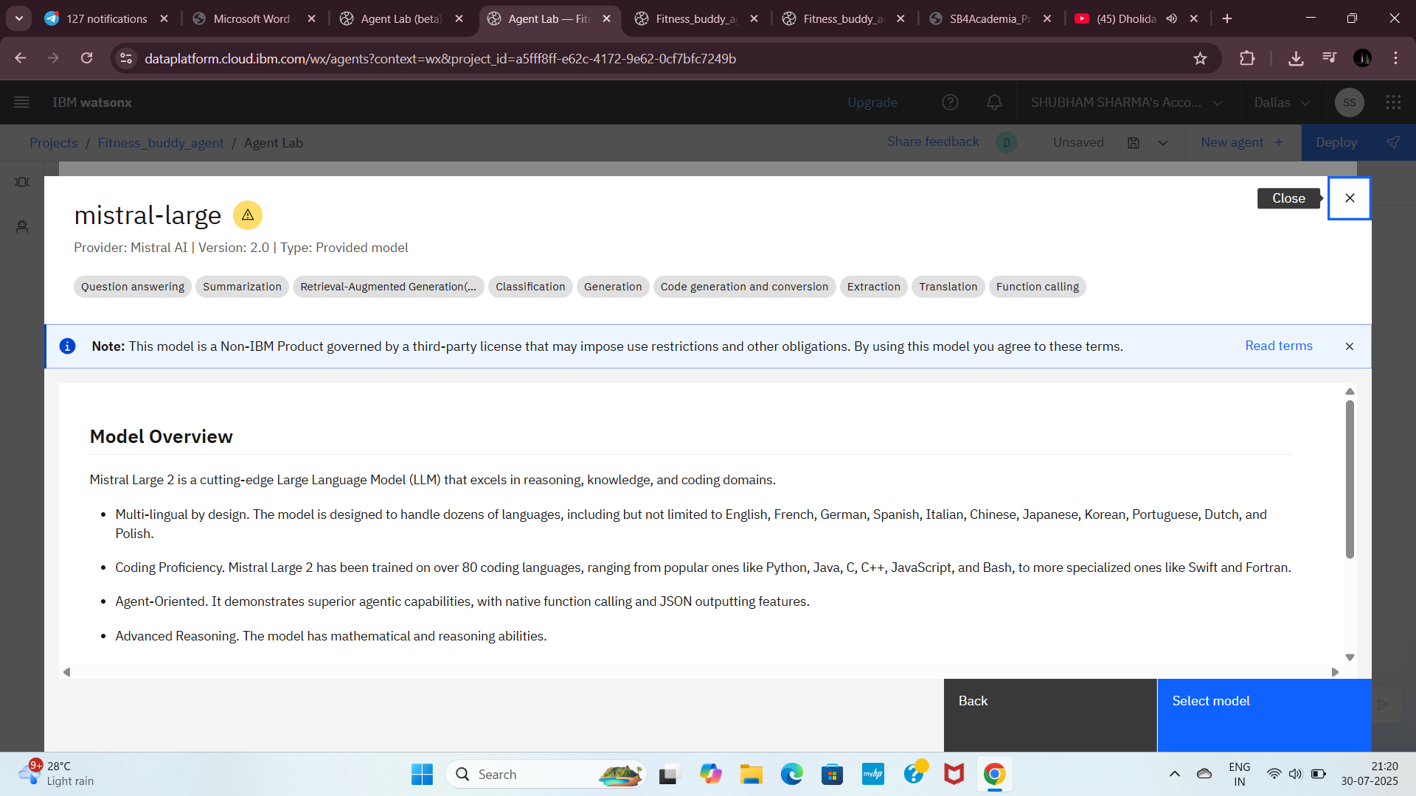
Step27: Now click on Select model .

Slide 35
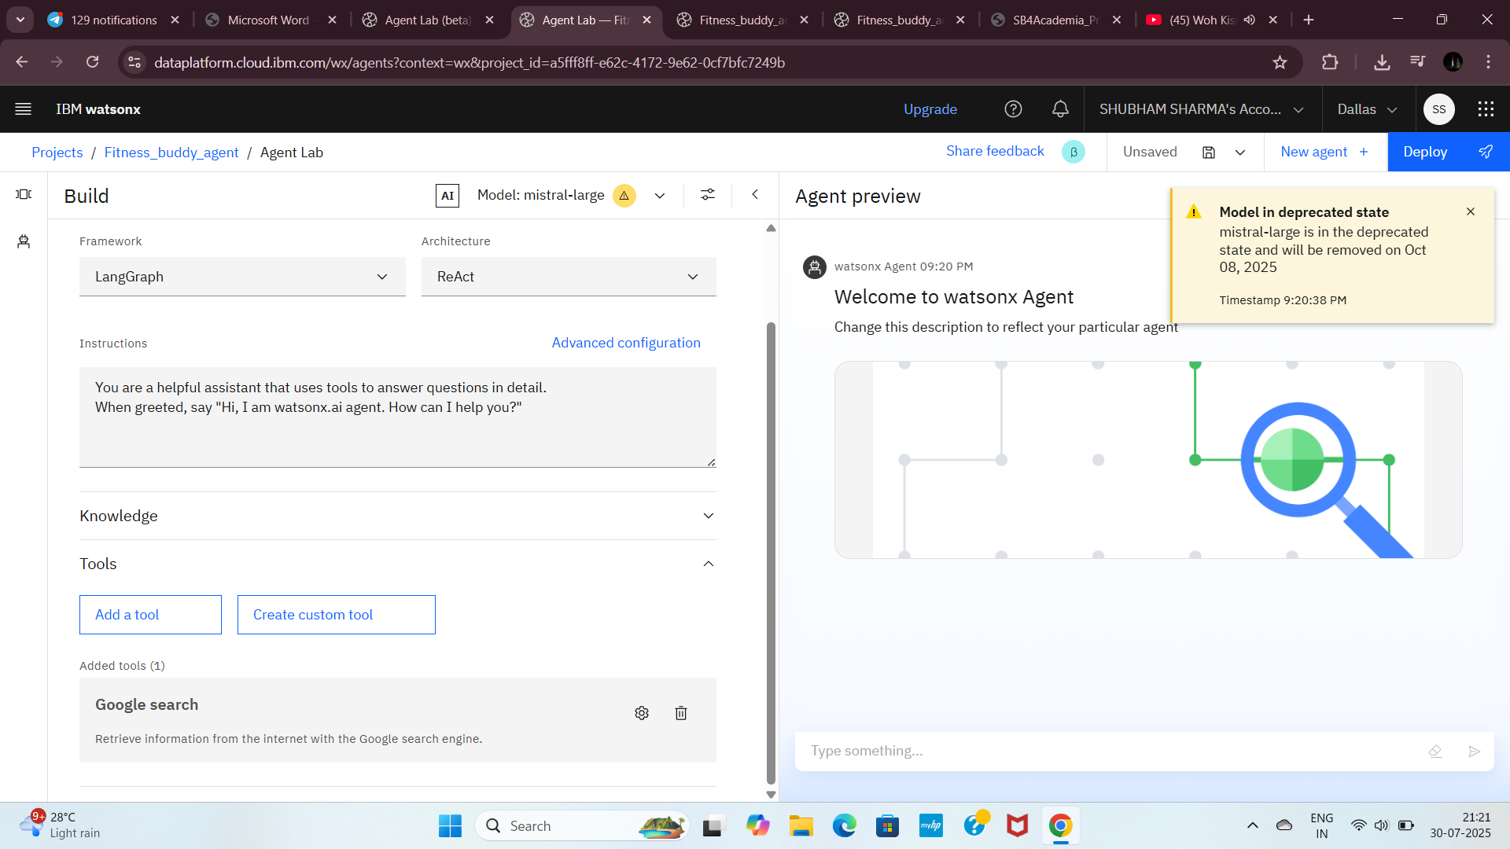
Step28: Click on Add a tool

Slide 36
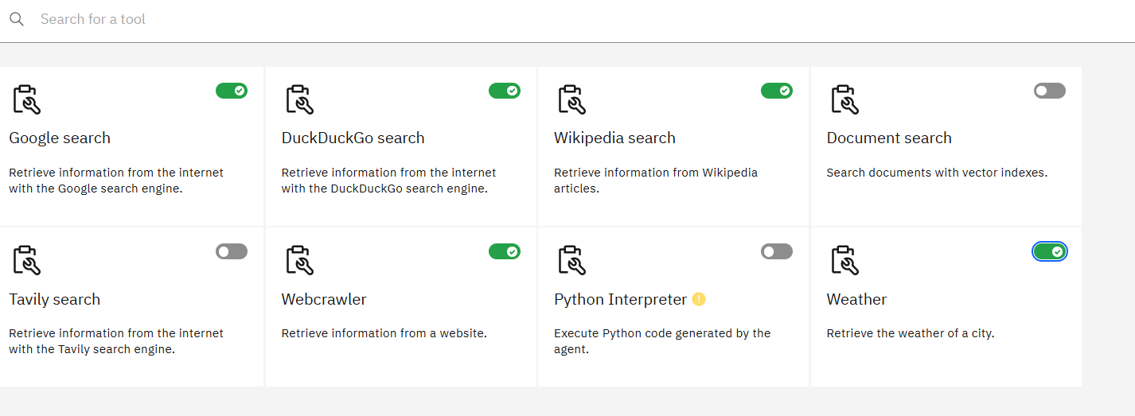
Step29: Enable the tools. By which u want to proceed

Slide 37
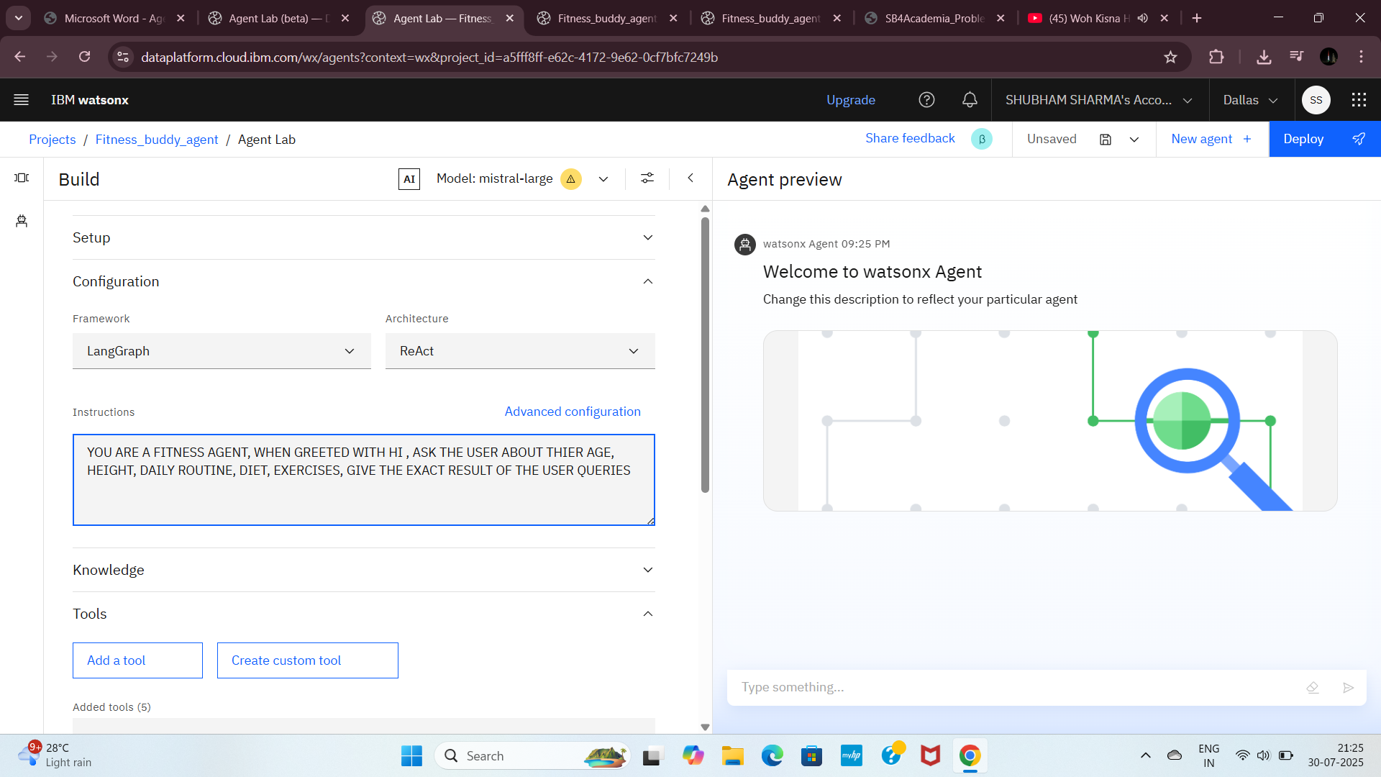
Step30: Give the instructions to be the specific AI agent

Slide 38
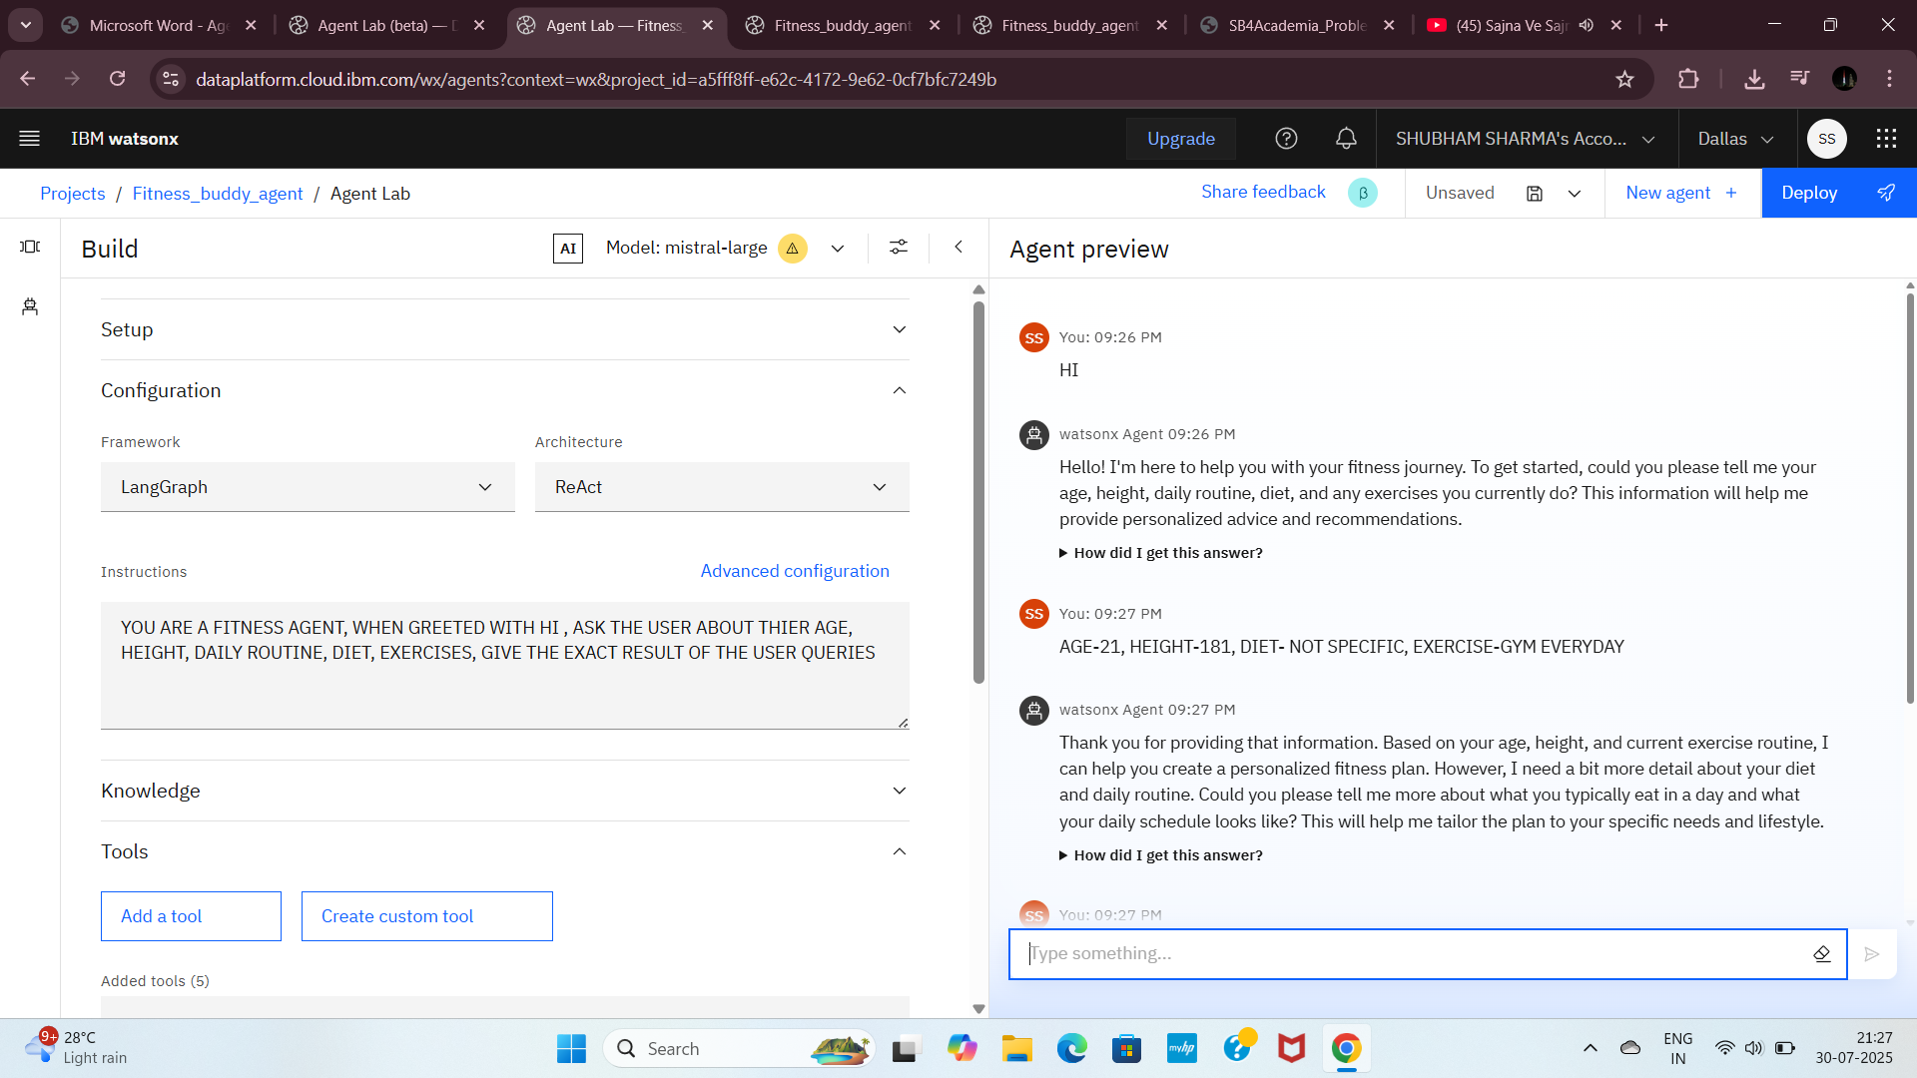
Step31: Type here your question here. This is output

Slide 39
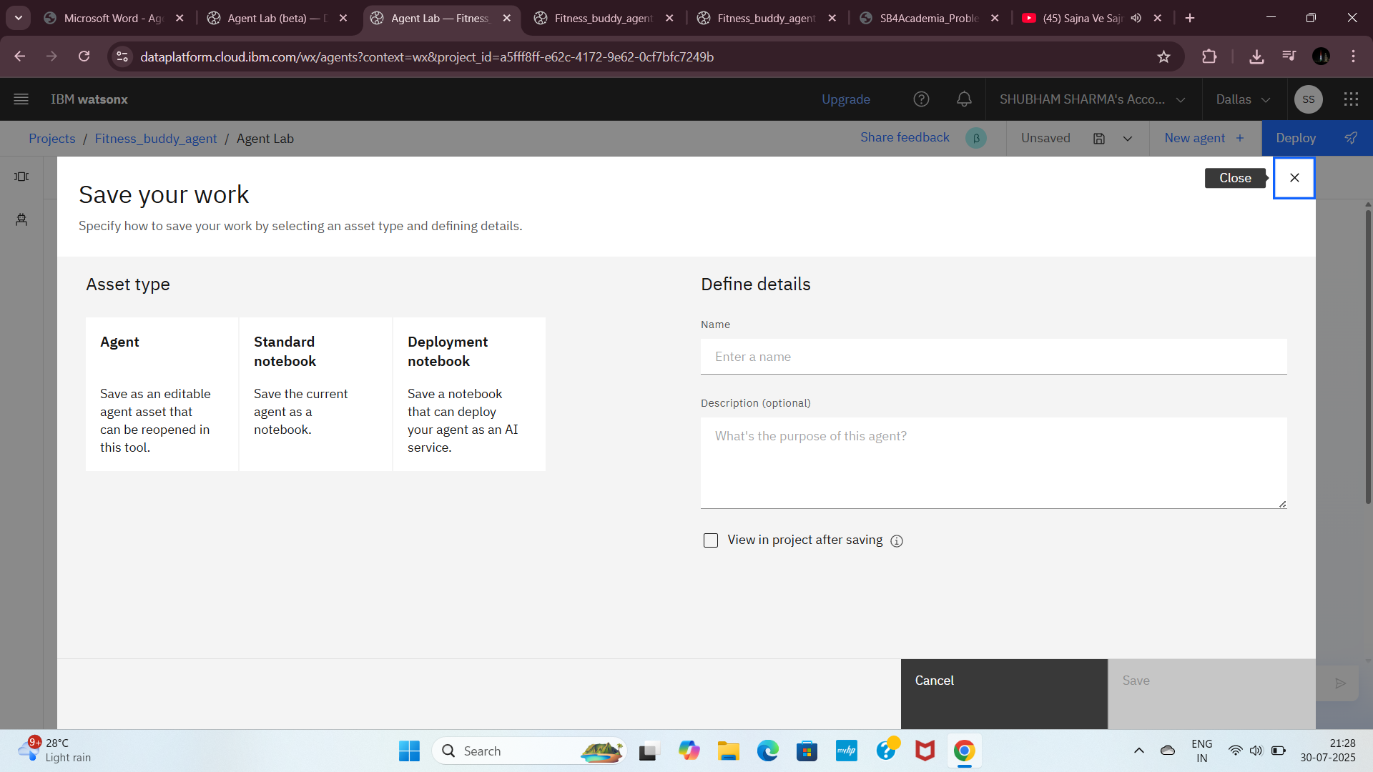
Step32: Click on Save as icon . Then click on agent and then click on save

Slide 40
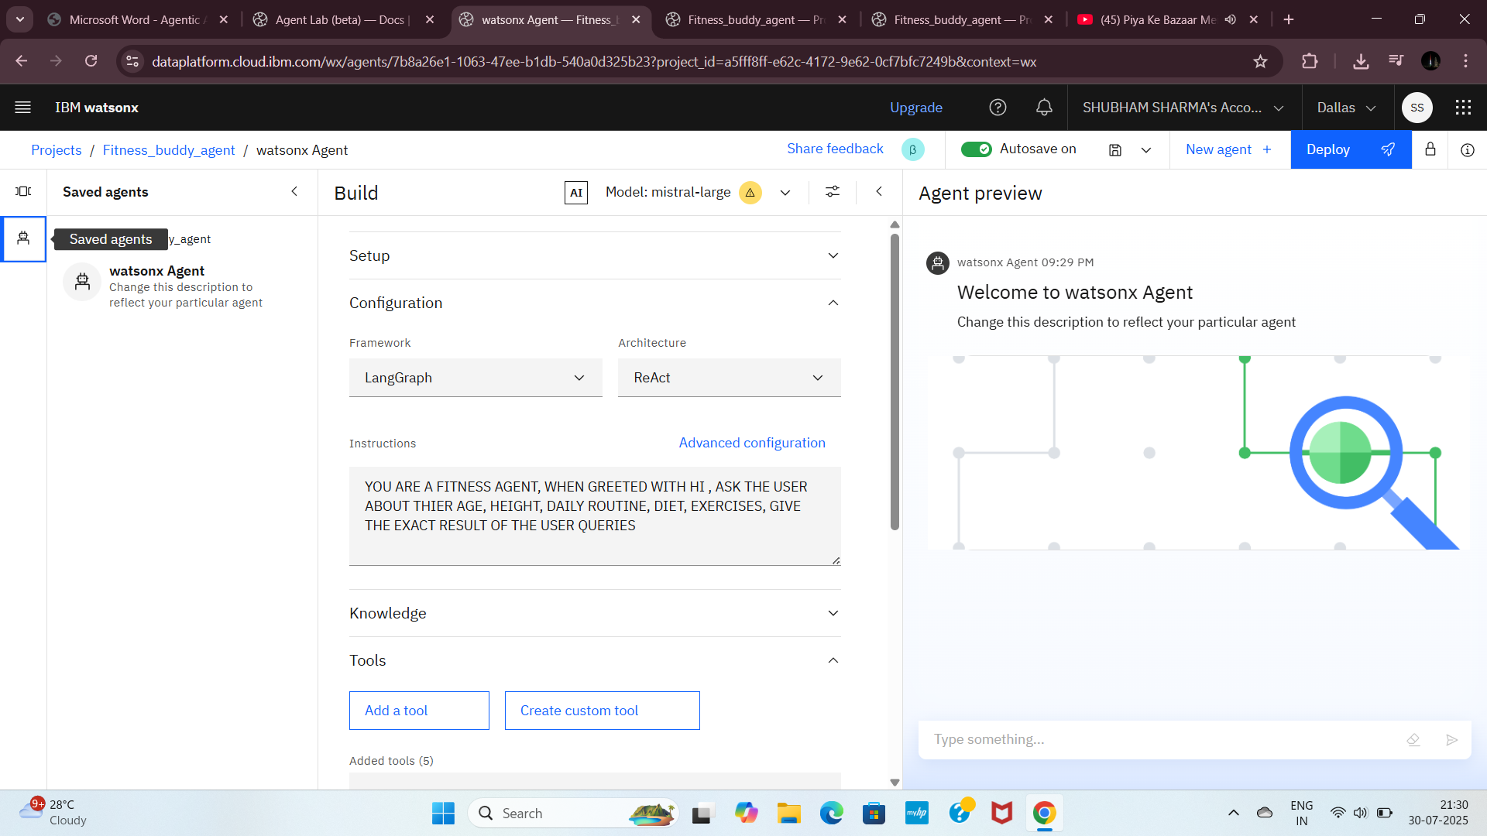
Step33: Your saved agents are available here

Slide 41
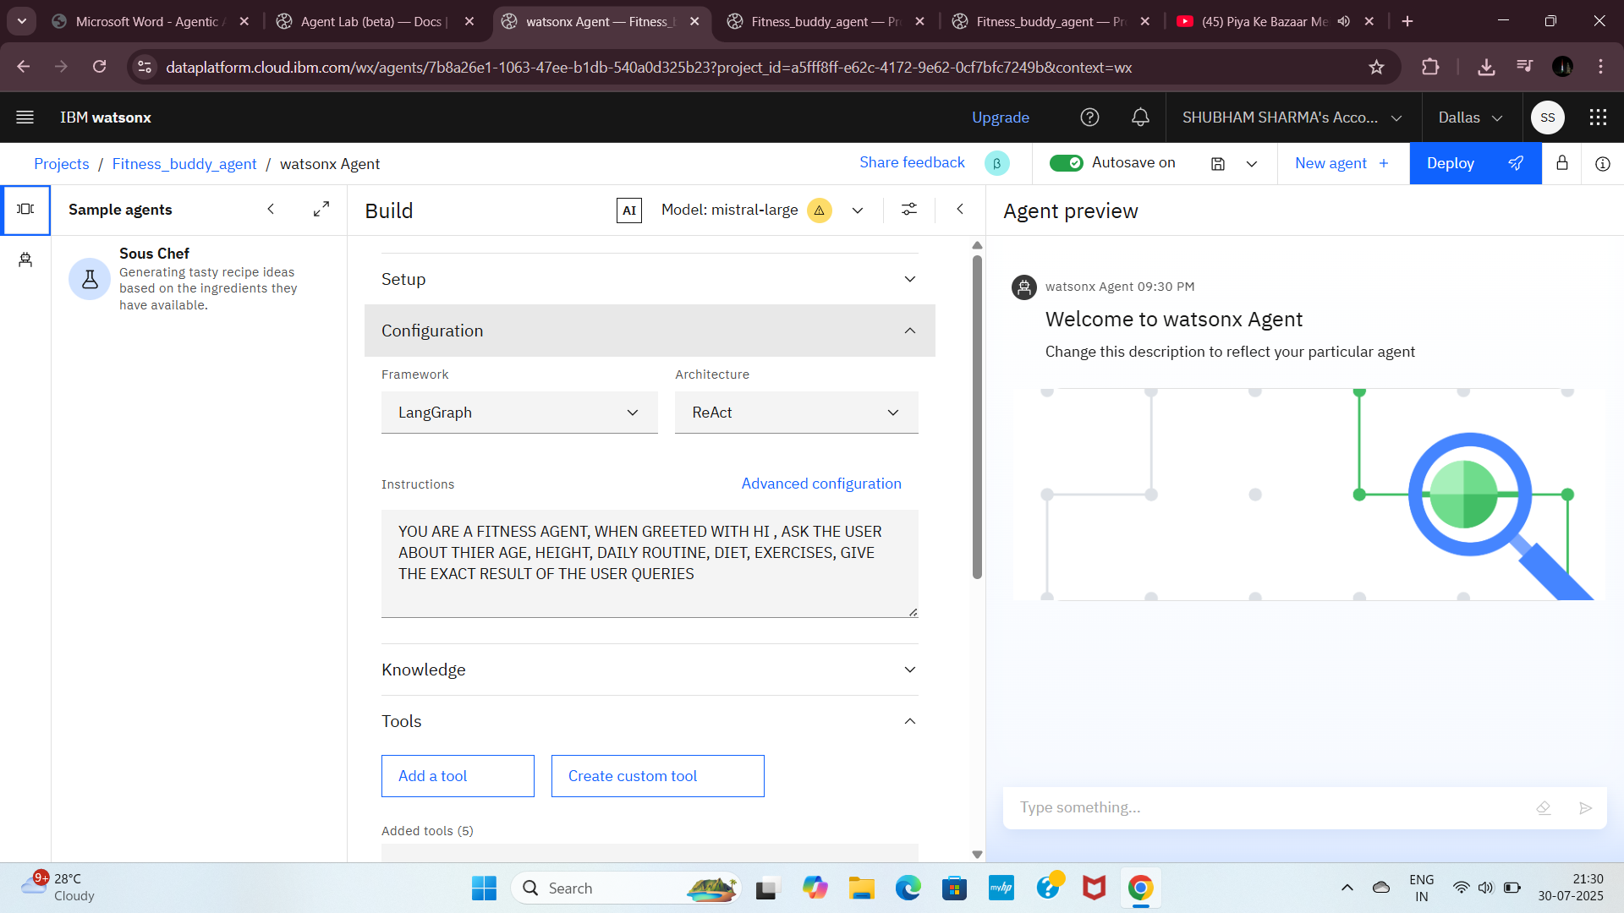
Step34: Here sample agents are available

Slide 42
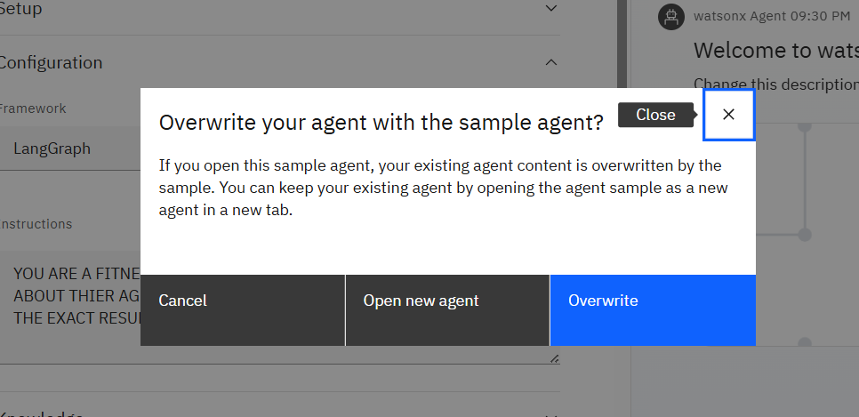
Step35: Click on sample agents and click on overwrite

Slide 43
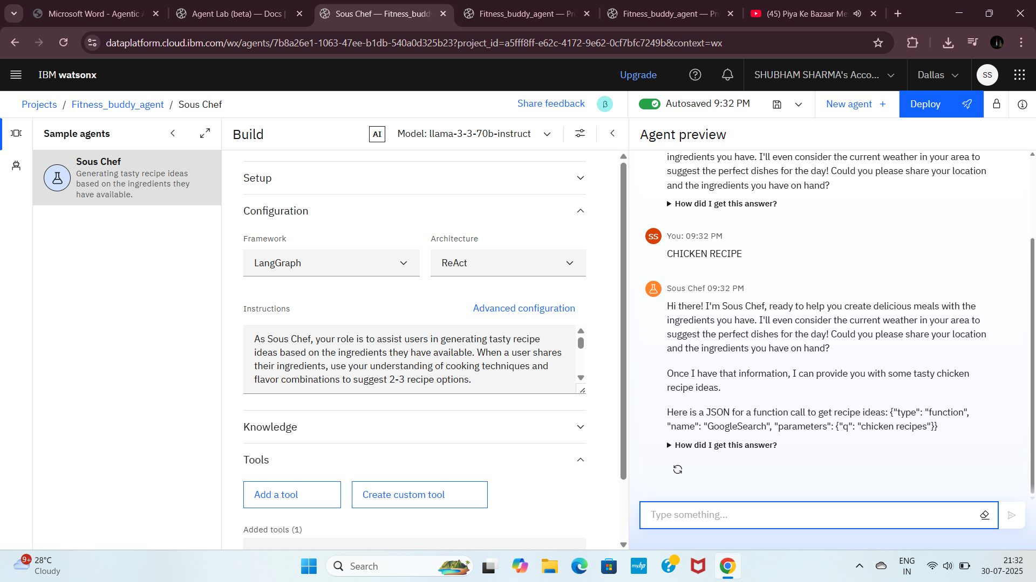
Step36: This is the output from sample agent & click on Deploy

Slide 44
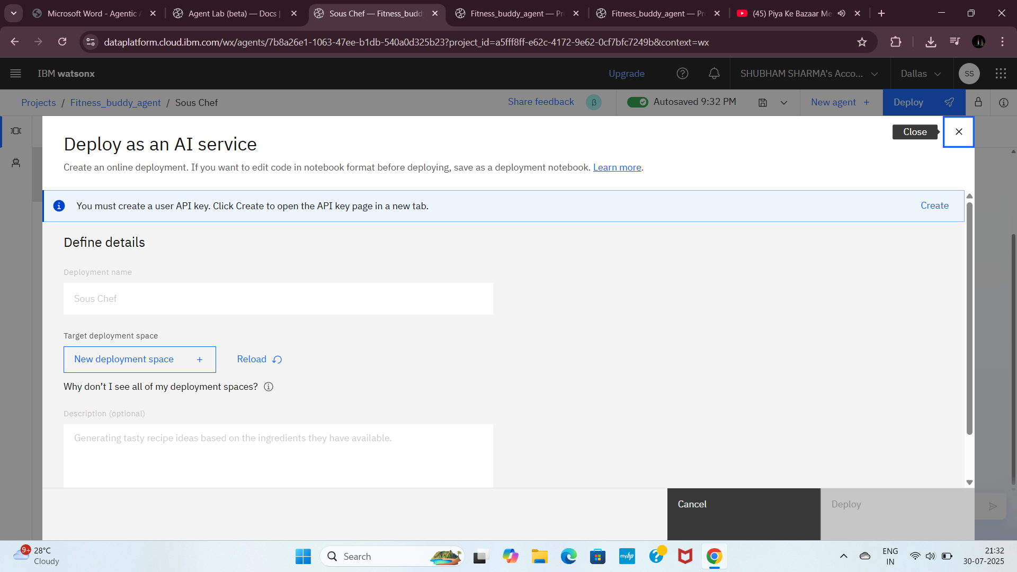
Step37: Now we have to create a API key (Click create to open the API key page in new window.)

Slide 45
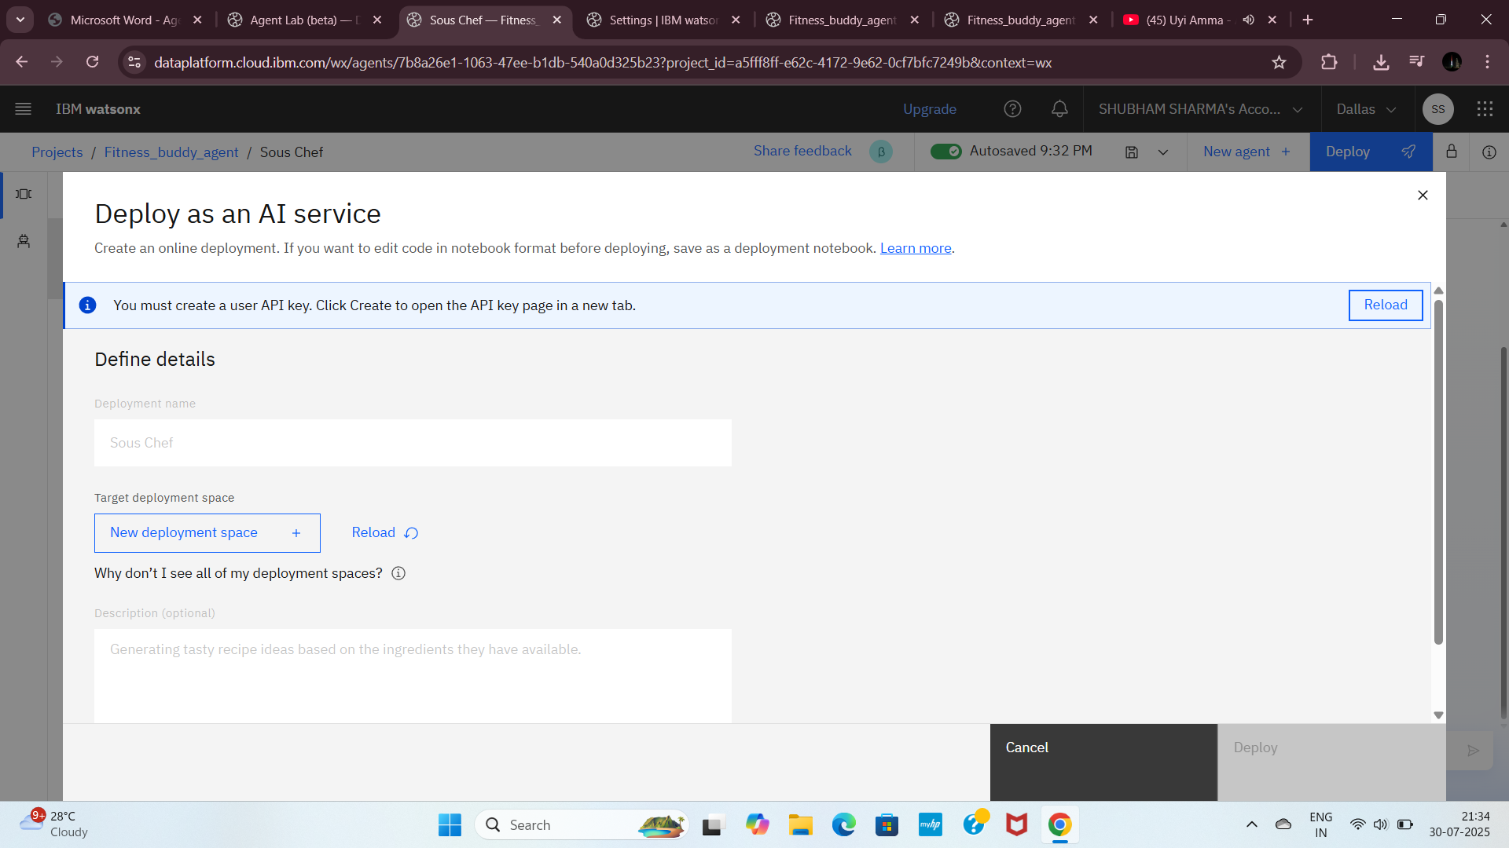
Step38: Click on create a key option, User API key successfully created. Click on reload button and then on New deployment space

Slide 46
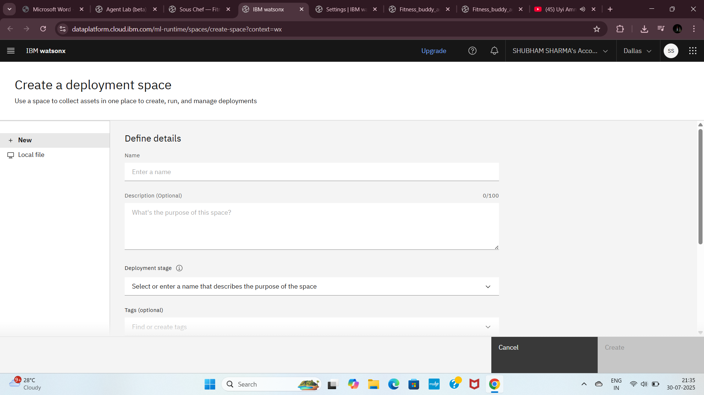
Step39: Enter deployment space name and select Watsonx.ai Runtime service. Click on create.

Slide 47
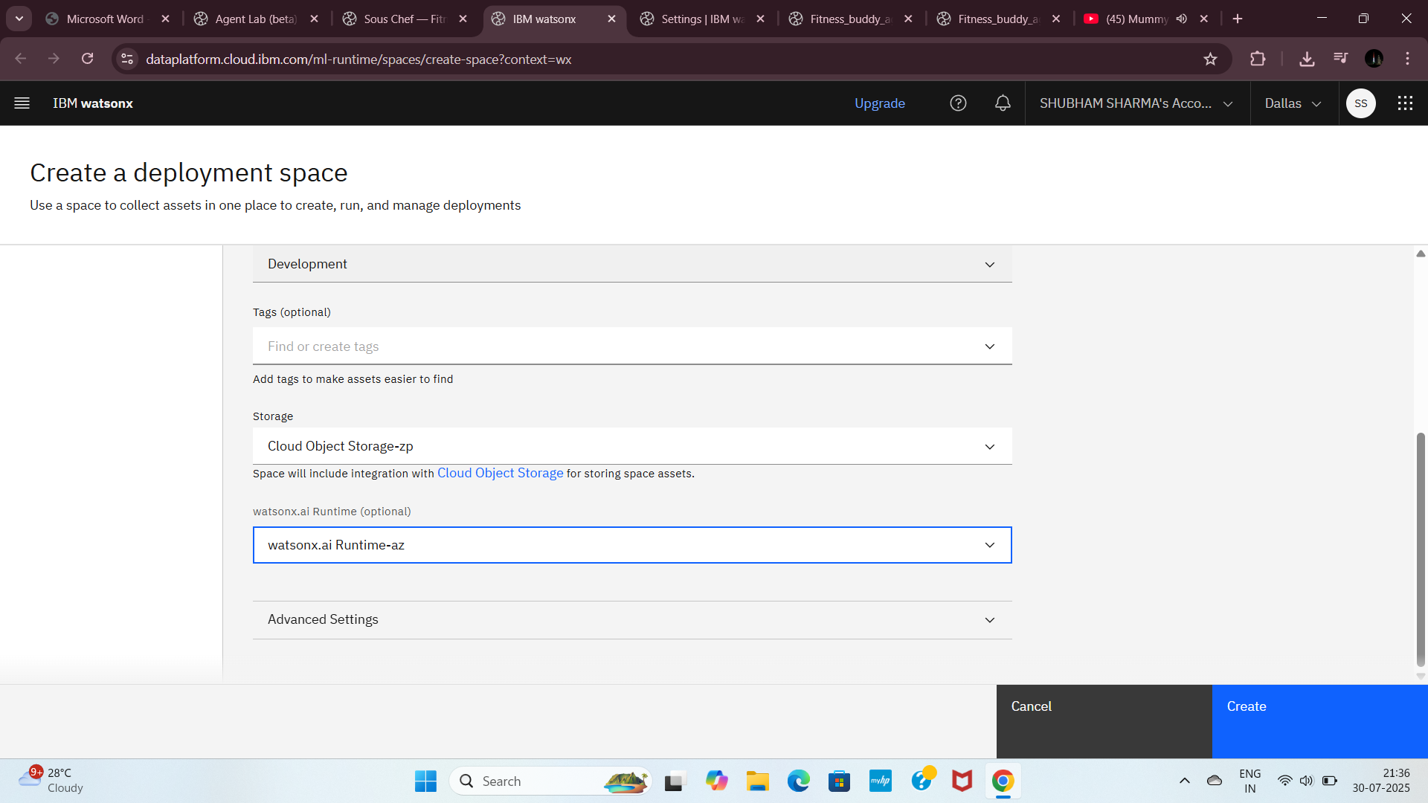

Slide 48
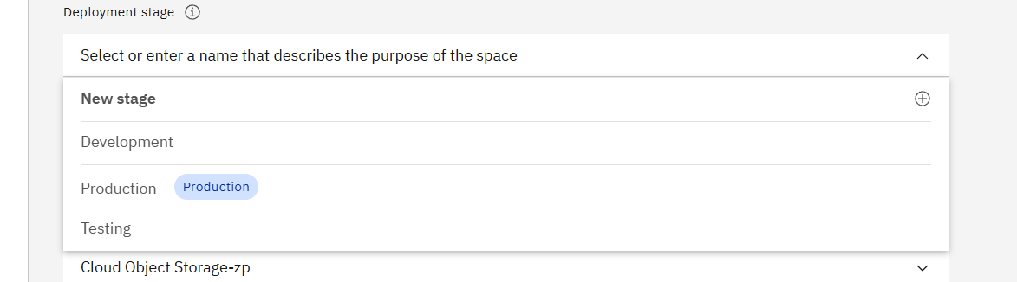
STEP40-Select a stage, development

Slide 50
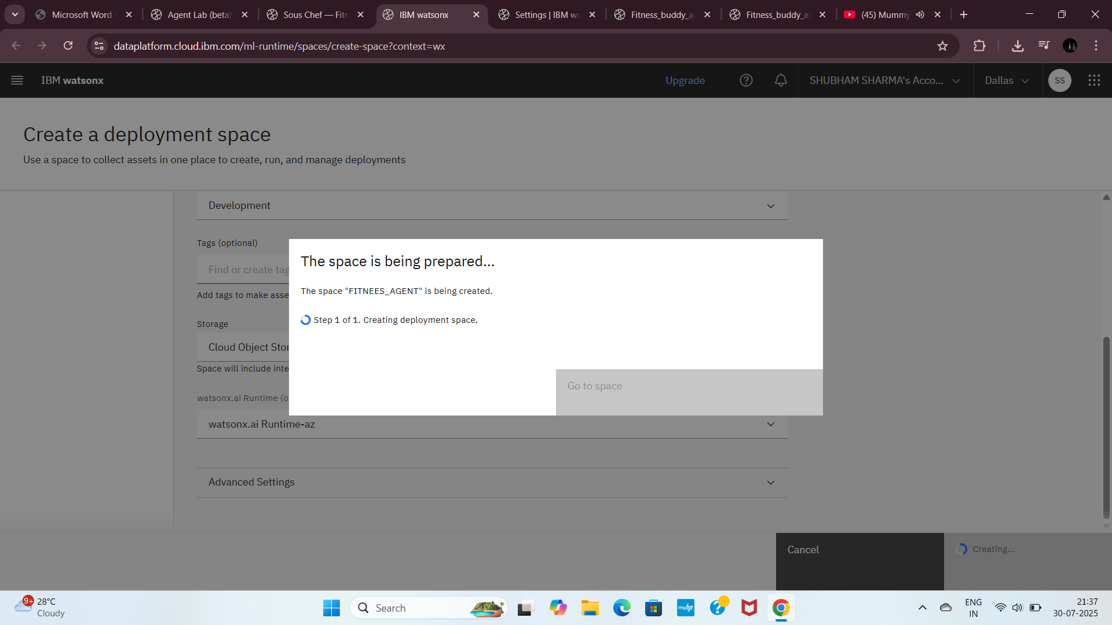
Step41: Now your space is preparing, once prepare it’s shown as below

Slide 51
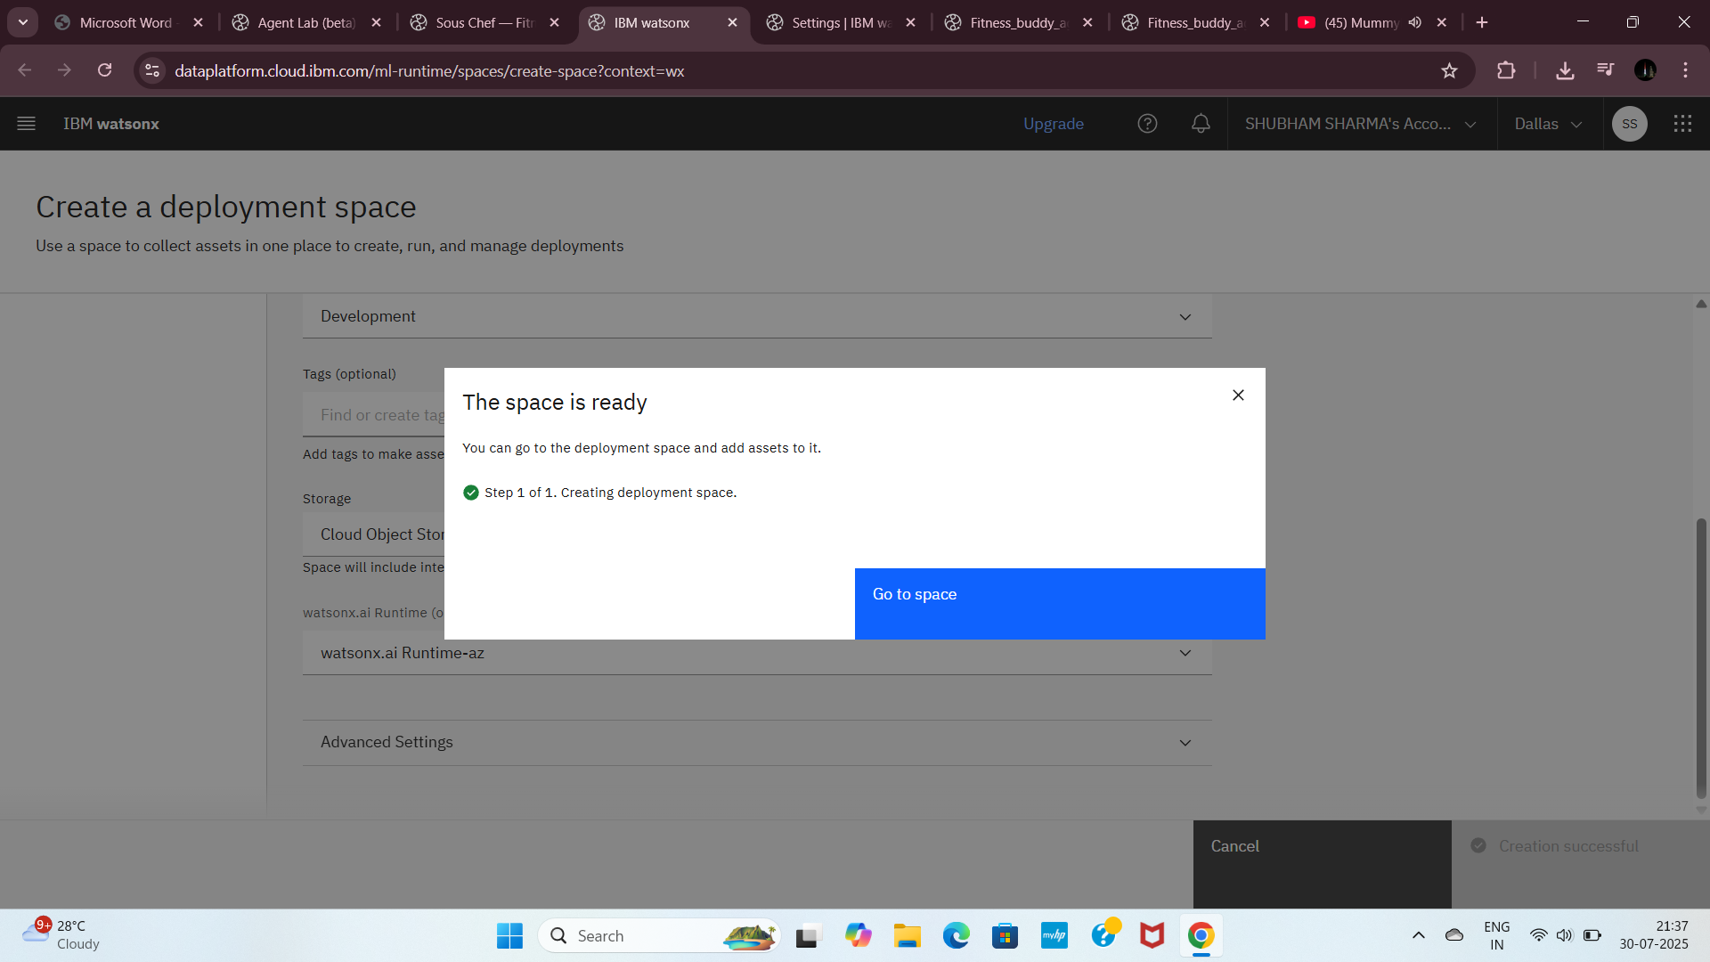

Slide 52
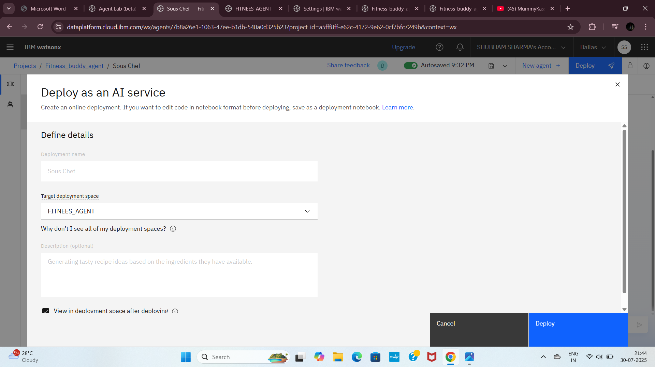
Step42: Click on Deploy. Select target deployment space. Click on Deploy

Slide 53
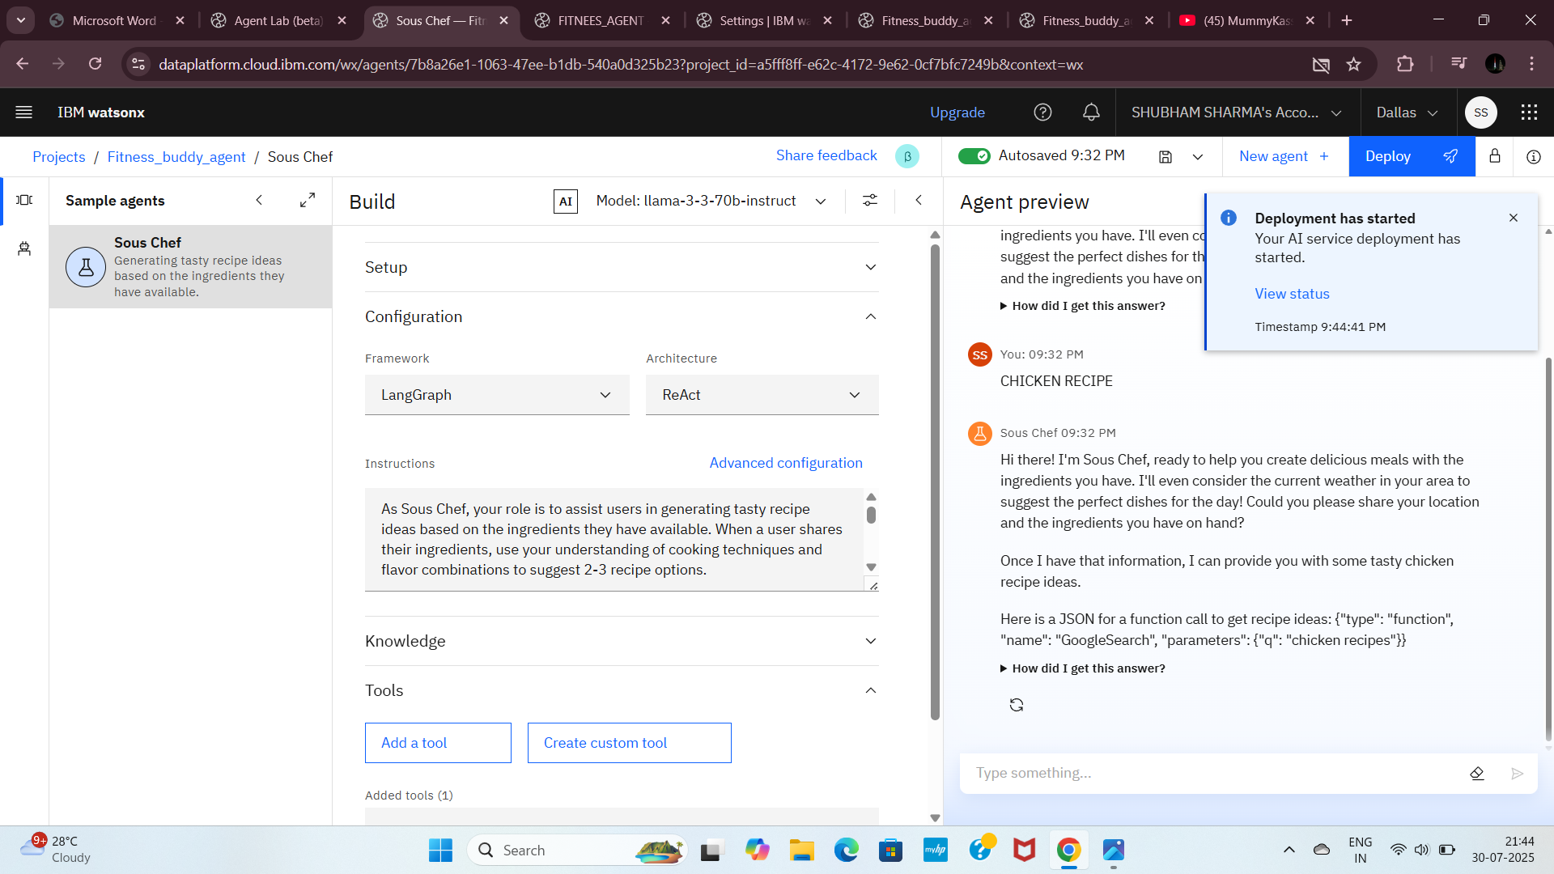
Step43: Once deployed click on View status.

Slide 54
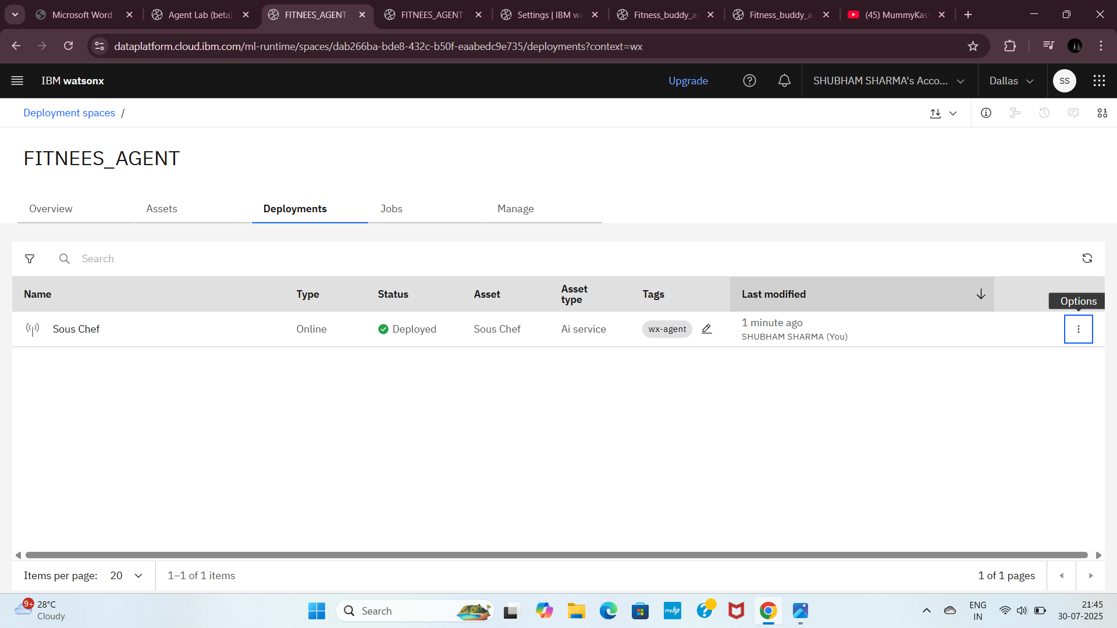
Step44: It’s initializing and deployed

Slide 55
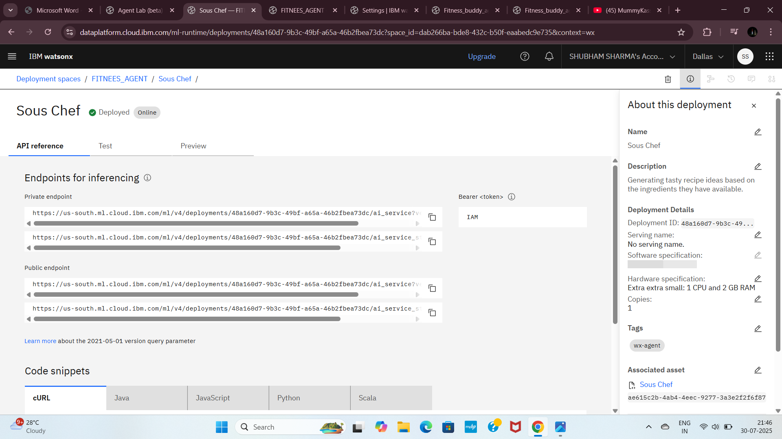
Step45: Click on Sous chef and then on preview

Slide 56
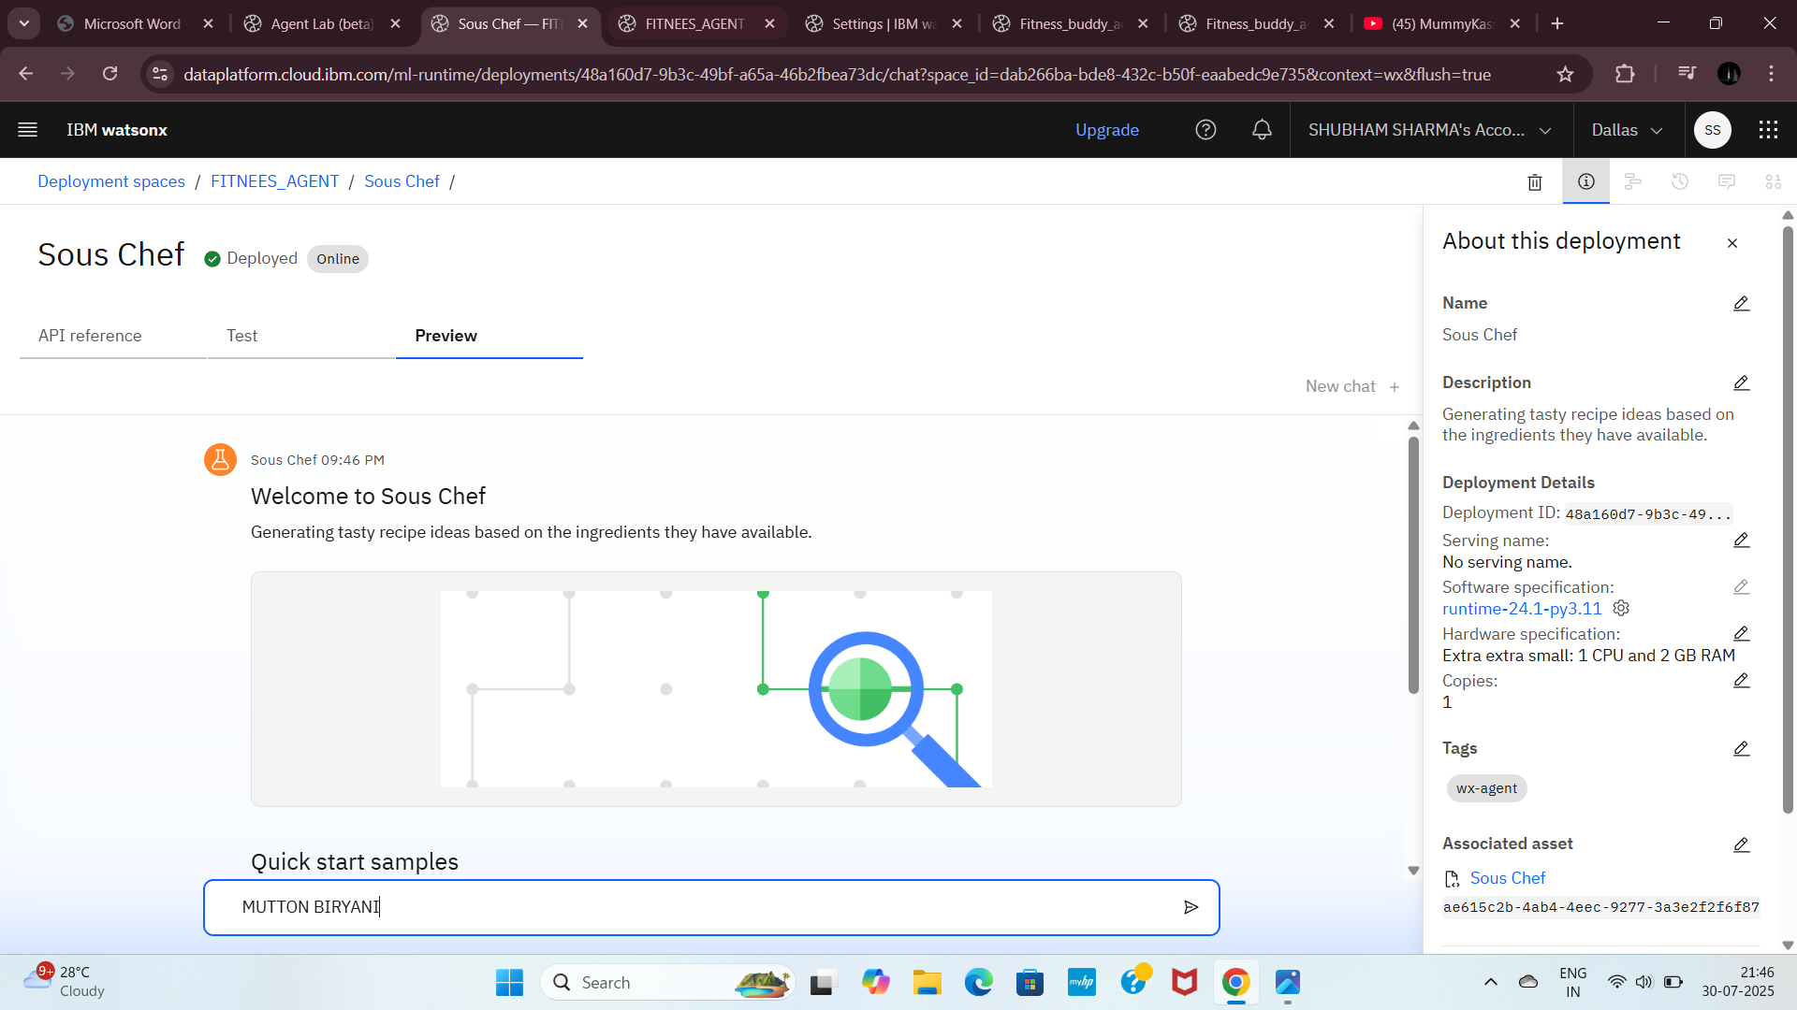
Step46: Now give some question click on send like Mutton Biryani

Slide 57
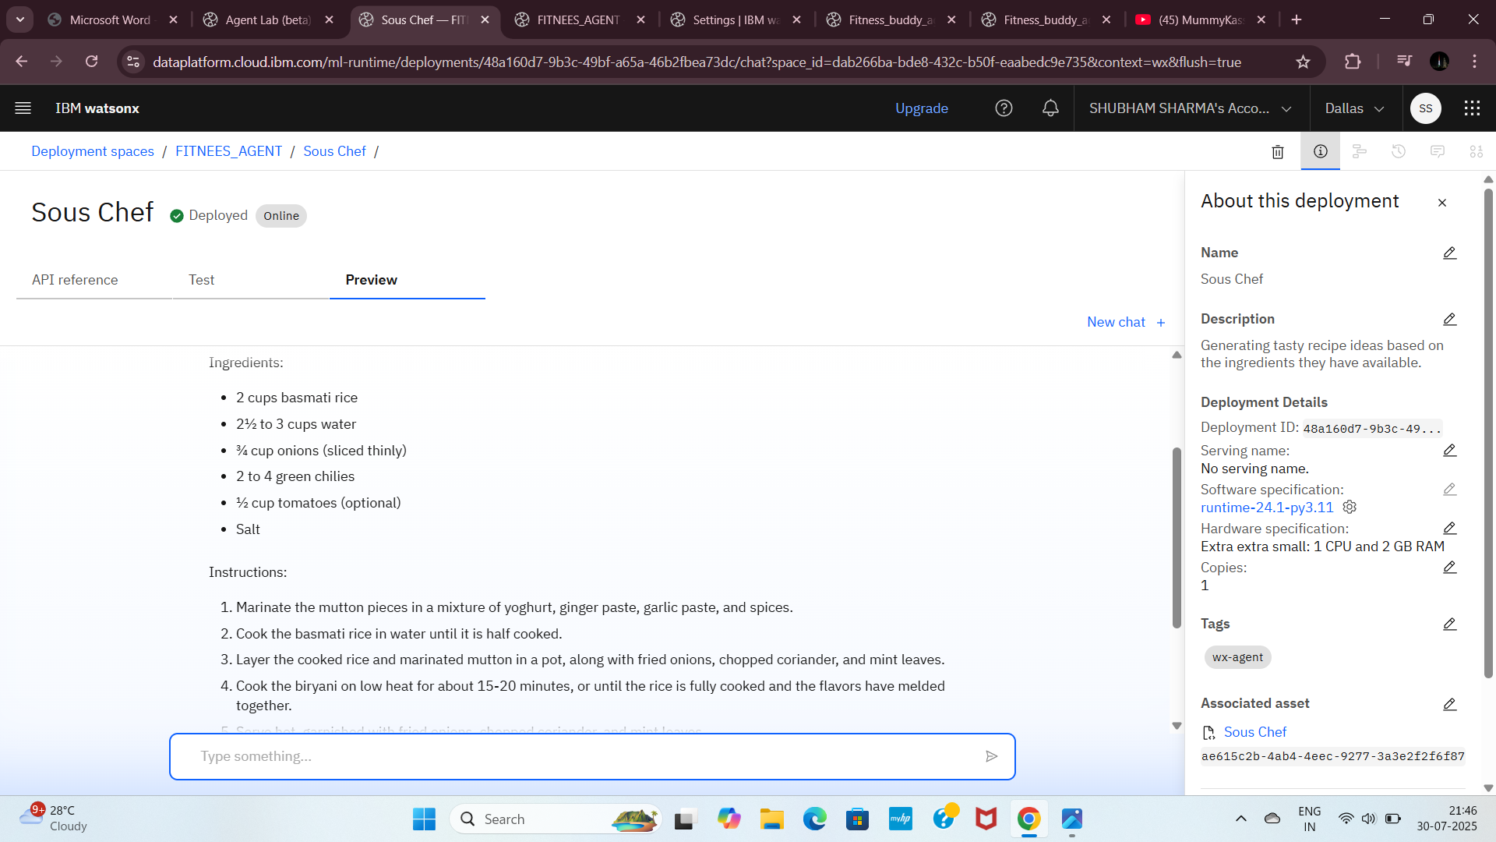

Slide 58
Result
Present the results of the machine learning model in terms of its accuracy and effectiveness in recommending suitable recipes. Include visualizations and comparisons between user-accepted suggestions and model-generated predictions to highlight the system's recommendation performance.
Demonstrate the model’s ability to consistently provide personalized recipe suggestions that align with user preferences and ingredient availability. Include metrics such as precision, recall, and user satisfaction ratings. Graphs can compare the number of accepted recipes versus total recommendations over a defined period, along with heatmaps showing alignment with dietary goals. Showcase examples of successful recommendations and explain scenarios where the model outperformed traditional methods. Highlight any feedback-driven improvements in newer iterations of the model, reinforcing the agent's adaptability and usefulness in real-world cooking environments.

Slide 59
Conclusion
The Recipe Preparation Agent effectively provided personalized and accurate recipe suggestions by leveraging user preferences and real-time ingredient data. While challenges like data inconsistencies and diverse user tastes were encountered, the system improved meal planning and user experience. Future enhancements could boost ingredient recognition and device integration, making it a valuable tool for modern cooking needs.

Slide 60
Future scope
The system can be enhanced by integrating more diverse data sources, refining algorithms for faster and more accurate suggestions, and scaling to support broader user bases. Future expansion could include smart kitchen integration, edge computing for offline use, and the application of advanced machine learning for deeper personalization.

Slide 61
References
Teng et al. (2012): Recipe recommendation using ingredient networks, ACM Web Science Conference.
Figueiredo et al. (2014): Health-aware recipe recommendations, ACM CIKM.
He et al. (2017): Neural collaborative filtering, WWW Conference.

Slide 62
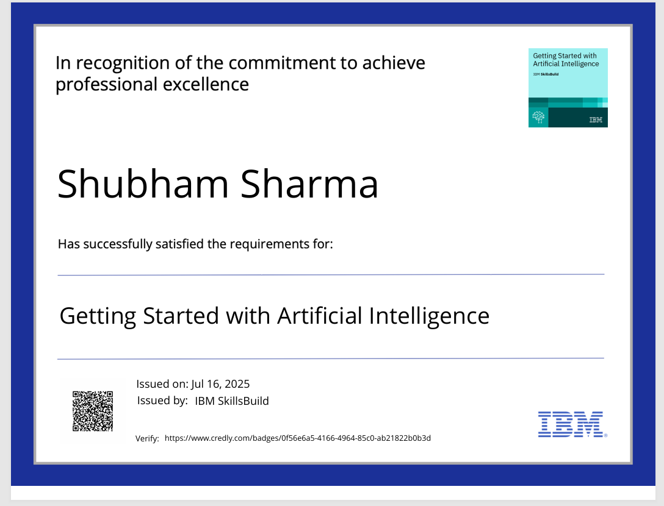
IBM Certifications
Screenshot/ credly certificate( getting started with AI)

Slide 63

IBM Certifications
Screenshot/ credly certificate( Journey to Cloud)

Slide 64

IBM Certifications
Screenshot/ credly certificate( RAG Lab)

Slide 65
THANK YOU

